Slide 1
Circle K Chartering and Reactivation

Slide 2
Paperwork is available online at:
http://circlek.org/Resources/Membership/MemberGeneratedResources2/RecruitmentRetentionCharteringDownloads.aspx

Slide 3
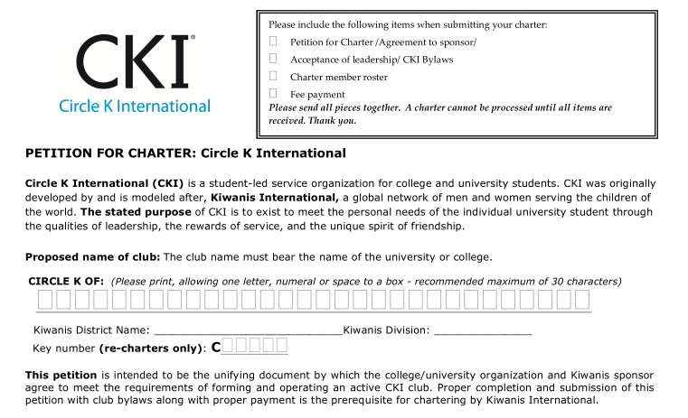
Requirements for Charter

Slide 4
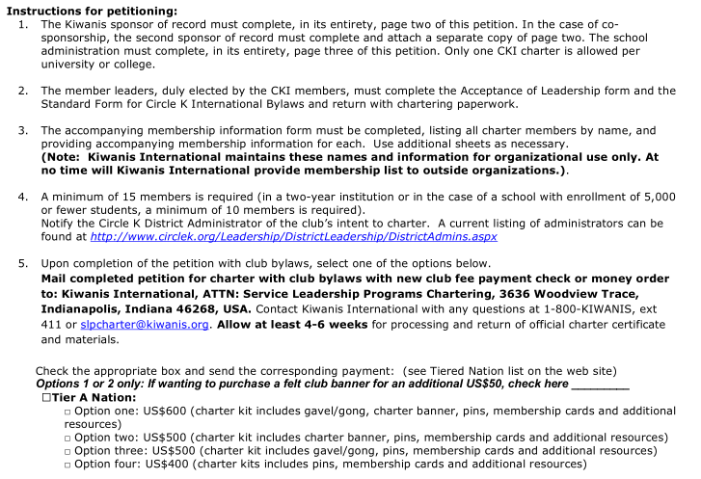

Slide 5
Kiwanis Sponsorship Requirements
Appoint an advisor who attends meetings and events
Financially support the Circle K club
Help secure a faculty advisor
Ensure training of Circle K Club Officers
Hold a planning session between Kiwanis and Circle K
Host joint events with Circle K
Ensure members attend conventions

Slide 6
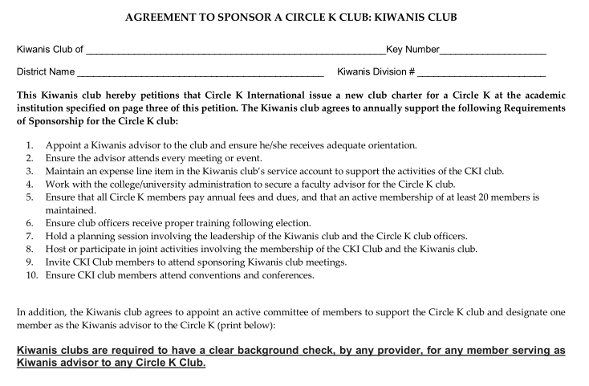

Slide 8
Sponsorship by Academic Institution
Provide a faculty advisor to the club to act as a representative of the university and ensure the club follows all policies outlined by the university
Ensure the club performs service-related projects
Confirm the club pays international fees and district dues
Encourage the club to send representatives to conventions and conferences
College Administrator signature can be director of student activities or a student organization director

Slide 9
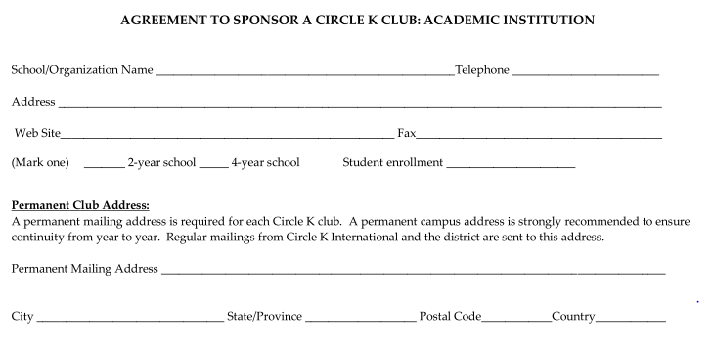

Slide 10
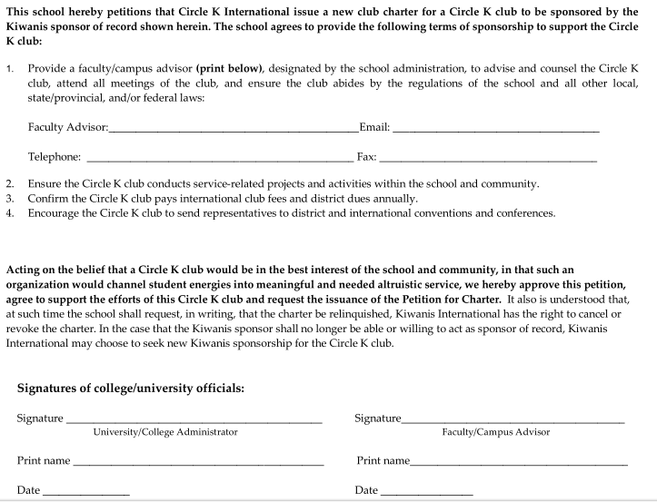

Slide 11
Acceptance of Leadership

Slide 12
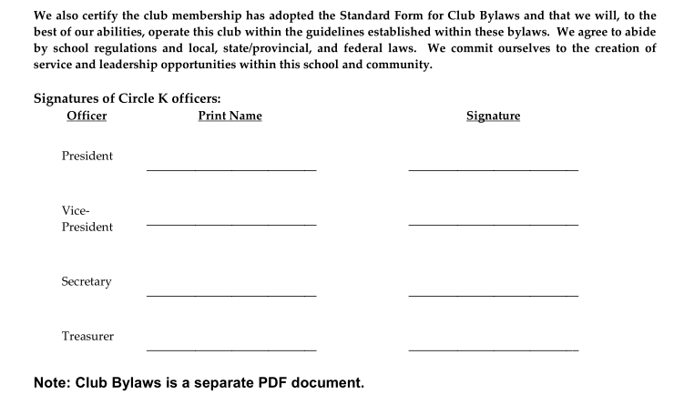

Slide 13
Charter Members
Four-year institutions with more than 5000 students enrolled = 15 members
Two-year institution = 10 members
Four-year institution with less than 5000 students enrolled = 10 members
Fill out contact information on chartering paperwork for officers and members

Slide 14
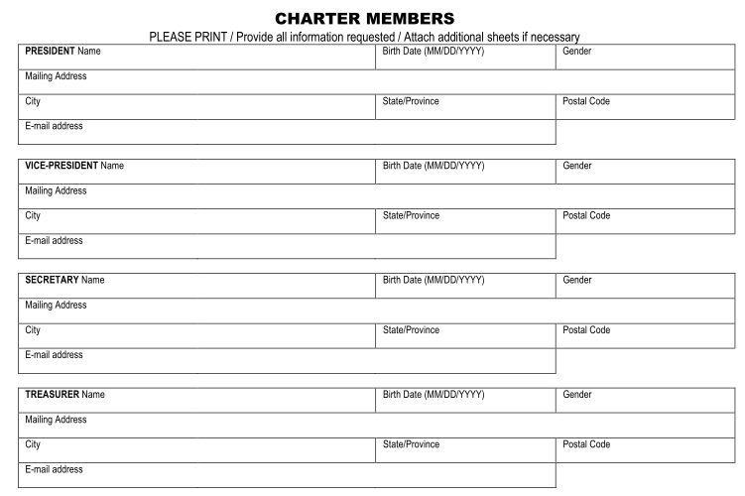
Charter Members

Slide 15
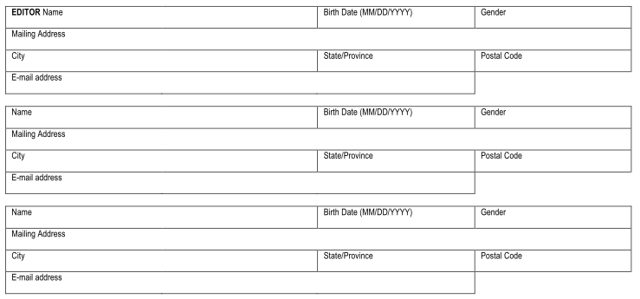

Slide 16
Fees
International Fees
Option 1: US$600 – gavel/gong, banner, pins, membership cards, resources
Option 2: US$500 – banner, pins, membership cards, resources
Option 3: US$500 – gavel/gong, pins, membership cards, resources
Option 4: US$400 – pins, membership cards, resources
District Fees
Vary by district and are per member rate ($6 to $12)
http://circlek.org/Join/Membership/Dues.aspx
Club Fees
Vary by club

Slide 17
Reactivation
Institutions that previously had a Circle K Club
The last year of dues-paid membership is within the last three years

Slide 18
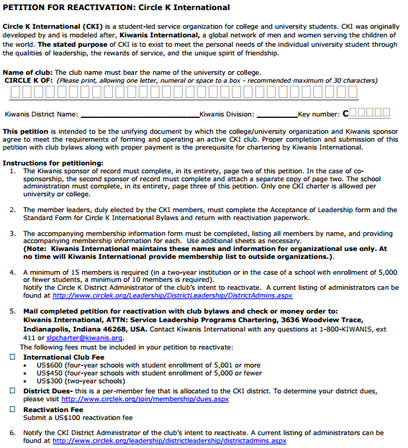
Fill in Key Number from Previous Charter

Slide 19
Reactivation Fees
International Fees
US$600 – four-year schools with student enrollment >5,001
US$450 – four-year schools with student enrollment <5,000
US$300 – two-year schools
District Fees
Vary by district and are per member rate ($6 to $12)
http://circlek.org/Join/Membership/Dues.aspx
Club Fees
Vary by club
Reactivation Fee
US$100

Slide 20
Bylaws
Can be found online: http://circlek.org/Resources/Leadership/Governance.aspx
Fill in red text with information specific to your club
Check with your school to ensure there are no additional requirement by them

Slide 21
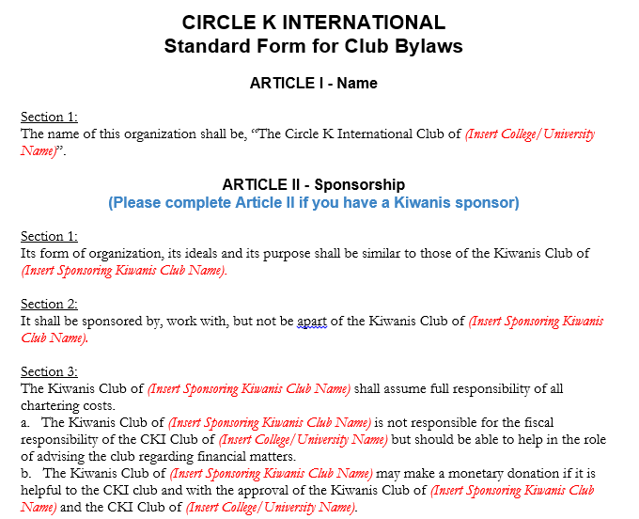

Slide 22
Contact
International – slpcharter@Kiwanis.org
Chartering and Club Building Chair Matthew Johnson – mattyboy.cki@gmail.com
Chartering and Club Building Secretary John Touhy – jtouhy6692@gmail.com
International Board Liaison Emily Bagwell – emilyabagwell@gmail.com

