Slide 1
CREATING A
MEMBERSHIP GROWTH STRATEGIC PLAN
FOR CLUBS

Slide 2
AGENDA
What is this plan?
Why plan for growth?
Steps to creating a plan
Finished product
Following your plan
Notes:
This is a brief overview of what we will be going through today. Get a pen and paper or an electronic device ready to take notes, because you do not want to forget any of this.

Slide 3
WHAT IS THIS PLAN?
Specific goals for membership growth
Recruitment and retention
Created BY and FOR your club
Actionable steps to achieve goals
Notes:
To begin: what is a membership growth strategic plan? The finished product is a plan created BY and FOR your club that is comprised of action steps to achieve membership growth, all guided by a specified goal. You can think of it as a contract to yourself and your club concerning what steps will be taken throughout the year to guarantee that you recruit AND retain more members in the coming year.
This can also be thought of as a process– one through which you prioritize membership growth in the beginning of your term and keep it at the forefront throughout the service year.

Slide 4
WHY PLAN FOR GROWTH?
More people = more impact
Be part of building a legacy for your club
Develop strategic planning skills
Allow more people to have the experiences you have had!
Notes:
Why is growth something that you should prioritize? Being part of CKI is being part of a global movement. Think about everything your club does to help your community. Now, multiply that impact by every club and every member worldwide. Inviting someone to be part of that gives them a chance to be part of that collective impact, and increases the impact you have as a club. You both get a friend out of recruiting new members, and recruiting members also sets your club up for years of success and service after you leave. But above all, recruiting gives others the chance to feel everything you have felt. Your club gives you amazing friends and experiences, and a chance to connect with so many people. CKI doesn’t encompass just one thing like other clubs, we encompass service, leadership, and fellowship, while providing many opportunities for development that are useful in professional and personal settings. Strategic planning, for example, is an easily transferable skill that can be gleaned through the creation of and adherence to a membership growth strategic plan.

Slide 5
STEPS TO
CREATING A PLAN
Notes:
Now that you understand WHAT a membership growth strategic plan is and why you should even care about growth– let’s talk about HOW to create one!

Slide 6
COLLABORATE
Teamwork is the key to success.
Invite multiple perspectives to the process
Ideal: planned by the outgoing and incoming officers during the transitionary period leading up to April 1
Notes:
Right off the bat, you need to understand that teamwork is key. Be sure this plan is informed by the entire club board (including the past board), not just an individual officer. There are likely many perspectives on what is best for your club, and you can keep each other accountable for goals collectively created. This also means that there will be more buy-in, excitement, and WILLINGNESS to adhere to the plan– it is not one person’s dream imposed unsolicited on everyone else in the club.

Slide 7
REVIEW
The present circumstances don’t exist in a vacuum.
How many paid / active members did your club have last year? The year(s) before?
Has your club been losing members, staying steady in membership, or growing?
Are there more new members or returners?
What has your club been doing (if anything) to actively recruit and retain new members?
Notes:
Before you create your plan, be sure that you are informed by the context of your club. Use these questions to guide in your reflection.
[*Note to presenter: ask these questions to members in the audience, to make this presentation engaging*]

Slide 8
CREATE A GOAL
You need a goal to give your plan direction.
Consider club’s context / history
What is realistic in terms of net growth?
Ex: If you lost three members last year, you need four new members to be at a NET growth of one member
Goal can be ambitious, but must be achievable
Clearly state goal at beginning of plan
Notes:
Your membership goals should be clearly stated in the introduction to your plan. What is realistic in terms of net* growth for the coming year? Use the data you reflected on during REVIEW to walk the line between overshooting and undershooting your membership goal. Your goal can be ambitious, but must still be achievable.

Slide 9
ACTION STEPS: RECRUIT
You need to bring people through the door.
How often will you “table” or pass out flyers per month?
Who will follow up with people who express interest, and how?
Will members be educated on recruitment tips during meetings?
Who will be the point person(s) in planning and implementing these initiatives?
Notes:
Action steps form the bulk of your plan. The intent is to outline every way in which your club can work towards growth. These action steps should be clearly defined, follow a specified timeline, and have certain people accountable for seeing them through.
First, you should consider action steps concerning effective recruitment… [*Ask audience*] What are YOUR answers to these questions? Are there any more questions that you can think to ask?

Slide 10
ACTION STEPS: RETAIN
Getting them in the door is one thing, getting them to stay is another.
How will you celebrate the identities and achievements of new and returning members?
How will member feedback be incorporated into decision-making and projects?
How will responsibilities of the club be shared?
How will members be educated about opportunities for growth available through CKI?
Notes:
Getting people IN the door means nothing if they do not STAY! The key to retention is fostering a healthy, welcoming environment where everyone’s presence is valued. Now it is time to consider action steps concerning effective retention... [*Ask audience*] What are YOUR answers to these questions? Are there any more questions that you can think to ask?

Slide 11
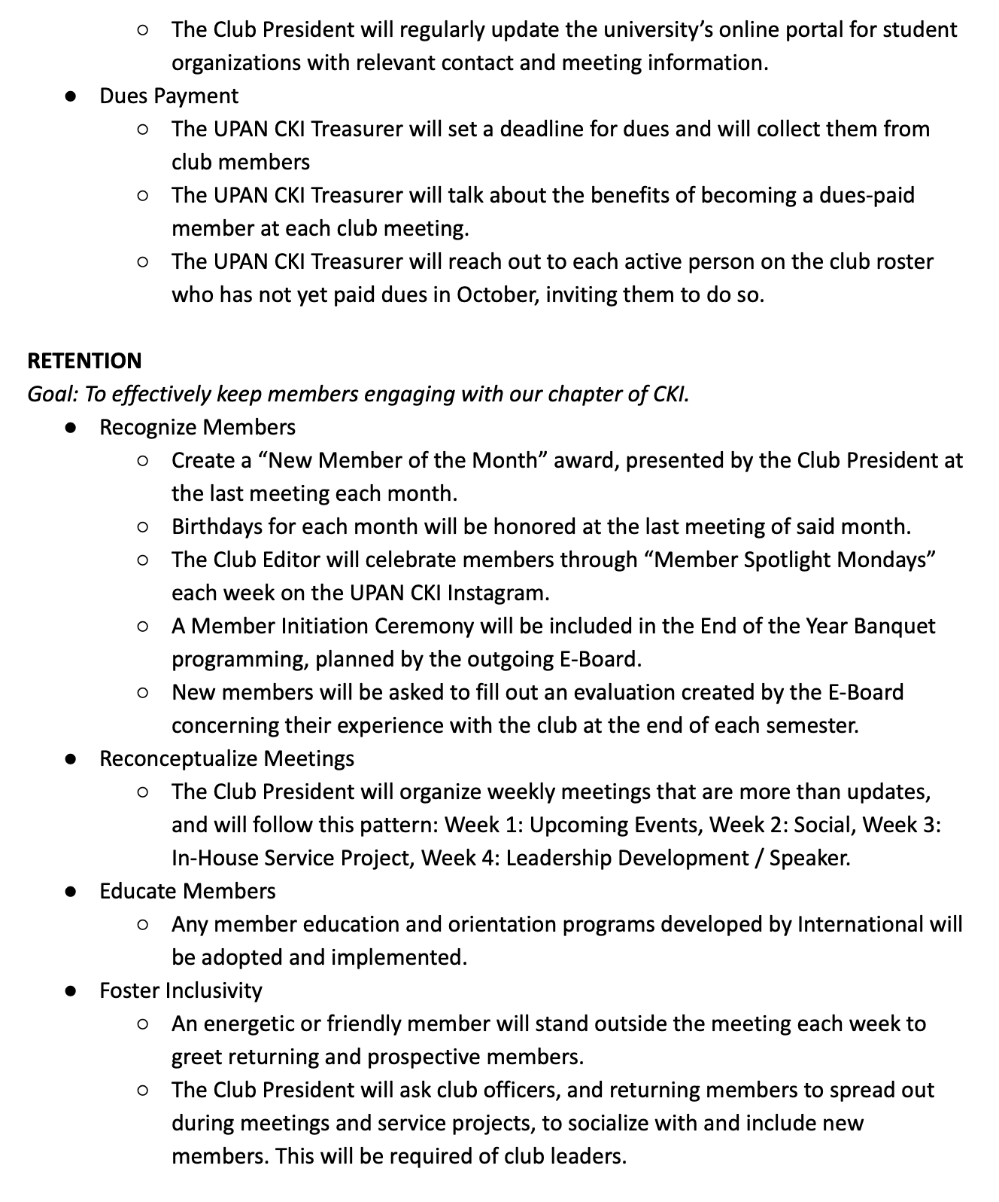
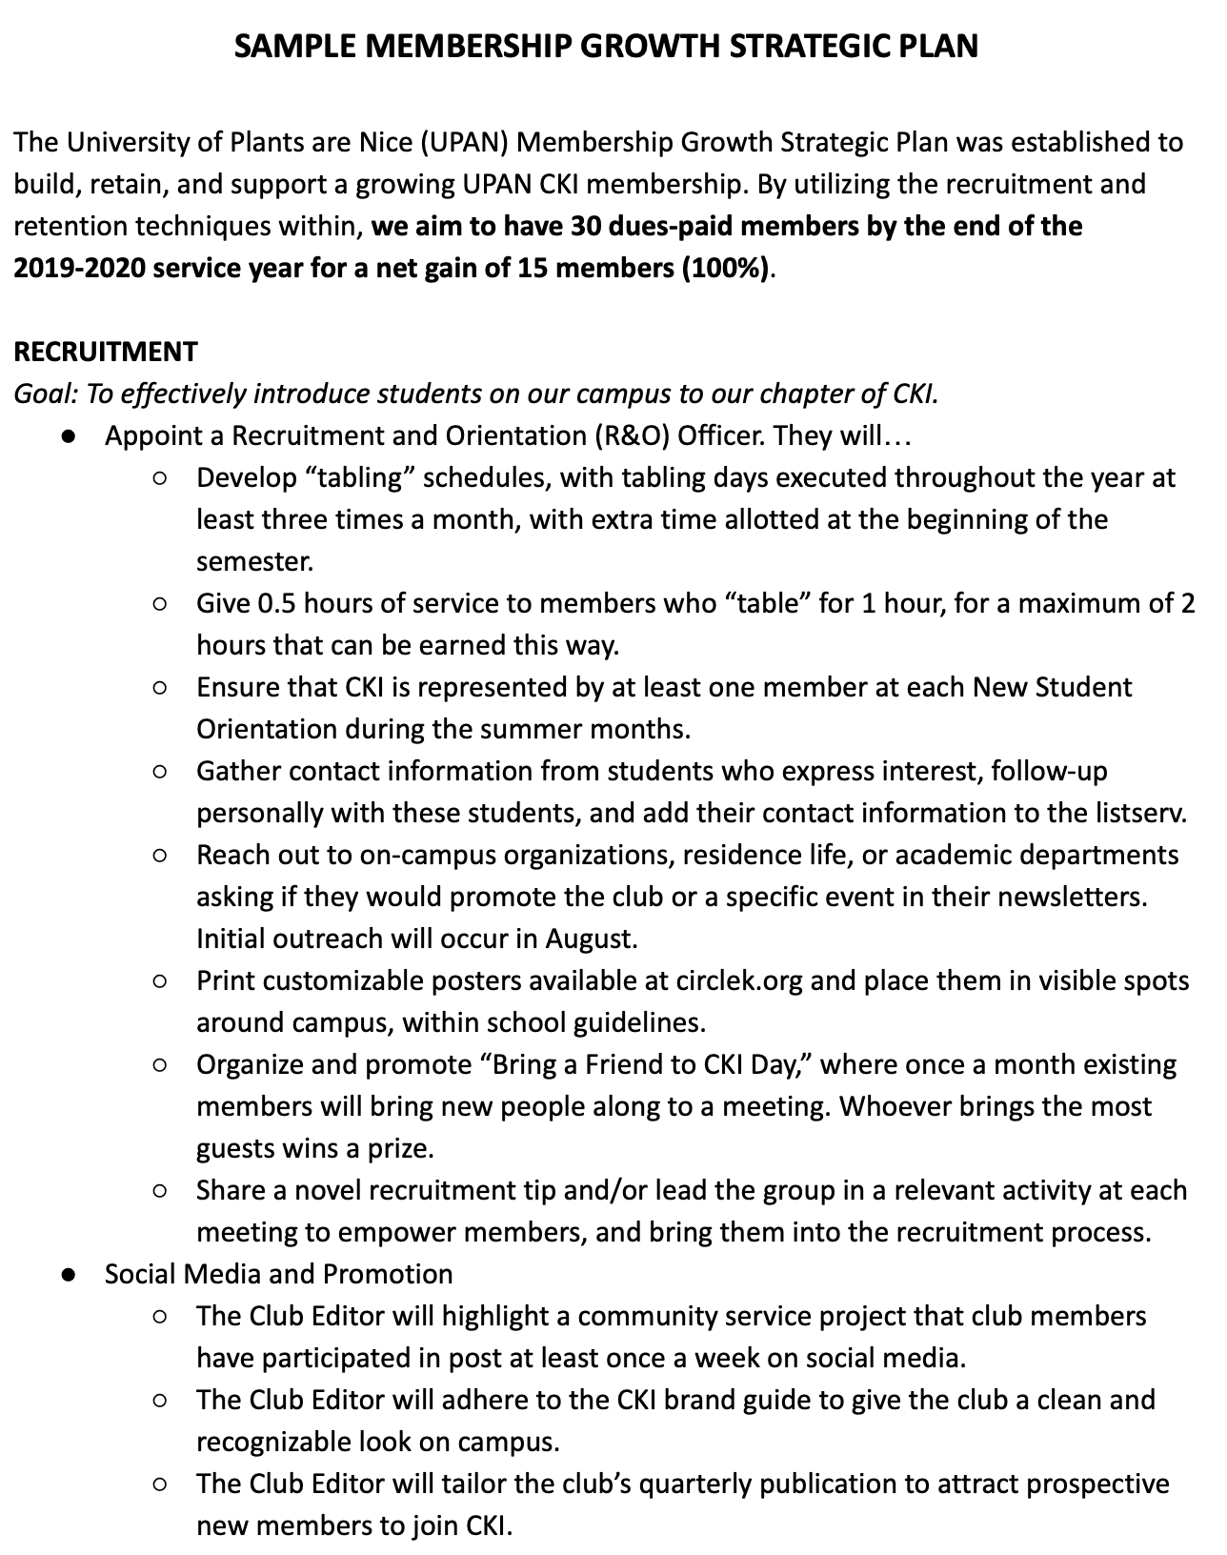
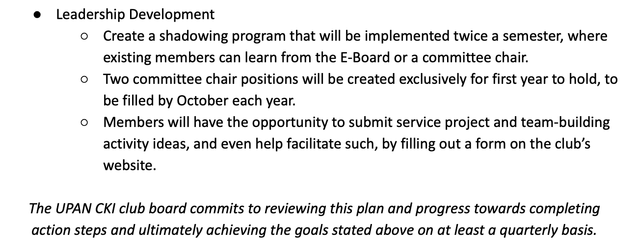
Notes:
This is what a finished plan can look like. This mock plan, in addition to a checklist of guiding questions (shared in this presentation) are available at circlek.org/resources > recruitment and retention for download.

Slide 12
FOLLOWING
YOUR PLAN
Notes:
This plan is not to be placed in a folder and forgotten.

Slide 13
REFLECT AND EVALUATE (PT.1)
Regularly return to and review goals as a group.
Have we adhered to all the steps committed to?
Have actors with specific roles to perform been held accountable?
How many members have we gained, or lost?
Are we on-track for our goal?
Should we reevaluate, or recommit?
Notes:
Regularly return to the goals you have created and analyze progress as a group at club board meetings. It is up to you how often “regular” is– once a month as a group is a standard allotment of time, if you want to really be on-top of the plan’s execution. It should be reviewed even more frequently, of course, by the president or whoever is responsible according to the plan / club structure to keeping members accountable in their responsibilities.

Slide 14
REFLECT AND EVALUATE (PT.2)
Two months before your term is over...
Fully review plan (yet again)
Initiate any last minute strategies to push yourself over your membership goal
Do not be afraid to implement new ideas!
Do not settle for numbers that are below your goal
Notes:
Two months before your year of leadership is over, fully review your plan once more and initiate any last minute strategies in your club to push you over your membership goal. Do not settle with numbers that are below your goal– there is ALWAYS more that can be done. Try some new strategies and implement them. Remember, a plus one membership growth is better than no growth at all.

Slide 15
REFLECT AND EVALUATE (PT.3)
At the end of the year...
Ask what has been learned that can be applied to next year’s plan
Facilitate a transition meeting between outgoing and incoming club board to develop the next plan
Include any additional reflections or lessons in transition materials to successor(s)
Notes:
At the end of the year, ask: what have we learned and how will we apply these lessons to next year’s plan (with the next generation of club leaders)? Facilitate a transition meeting between your outgoing board and the incoming club board where you review these lessons and assist the new board in developing their own plan. Include any additional reflections in the transition materials passed down to these new club officers.
At the end of the day, this is all about instituting a healthy cycle in the club that guarantees membership growth will be a major priority for every board right at the beginning of their terms, and will remain that way throughout. With this intentionality there is no question that your club will ultimately grow, and your club can have a greater impact.

Slide 16
QUESTIONS?
Presenter Name
Presenter Contact

