Slide 1
[Insert Club Name]
Informational Meeting

Slide 2

30 Second Promo Video
Notes:
https://www.youtube.com/watch?v=eI_dwxYzyGc

Slide 3
Meeting Overview
Icebreaker
What is Circle K
Motto, Tenants and Pledge
Benefits of Joining
Service Projects
The Eliminate Project
Semester Overview
Next Meeting Info

Slide 4
Ice Breaker

Slide 5
What is Circle K?

Slide 6

What is Circle K?
Circle K International (CKI) is the premier collegiate and university community service, leadership development, and friendship organization in the world. With more than 13,600 members in 14 countries, CKI is making a positive impact on the world every day.
We are the collegiate version of Kiwanis or Key Club!

Slide 7
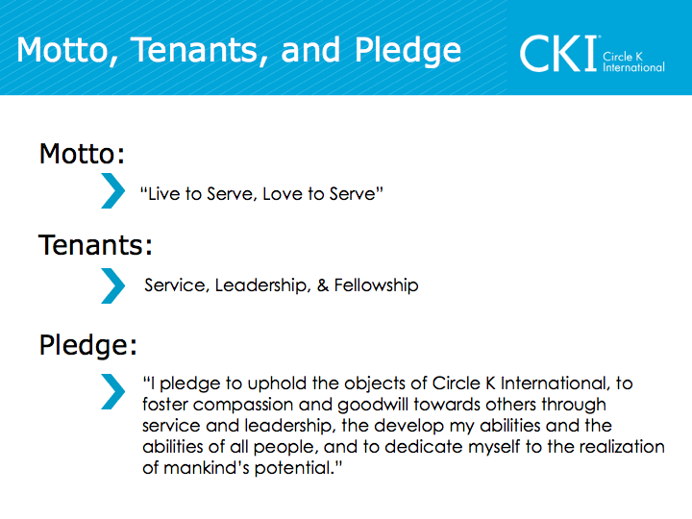

Slide 8
Benefits of Joining

Slide 9
Benefits of Joining
Become a member of the largest collegiate service organization
Scholarship opportunities
Contact with professionals/ networking
Conventions
Life-long friendships
Travel opportunities
Individual recognition/ leadership opportunities
Ability to do service on your campus and in
the community
Many other reasons

Slide 10
Service Projects

Slide 11

Kinds of Projects We Do
The WASH Project (UNICEF)
Trick-or-Treat for UNICEF
March for Babies (March of Dimes)
Head shaving for childhood cancer awareness (St. Baldrick’s Foundation)
Food Drives (Students Team Up to Fight Hunger “STUFH”)
Our service makes a difference!

Slide 12
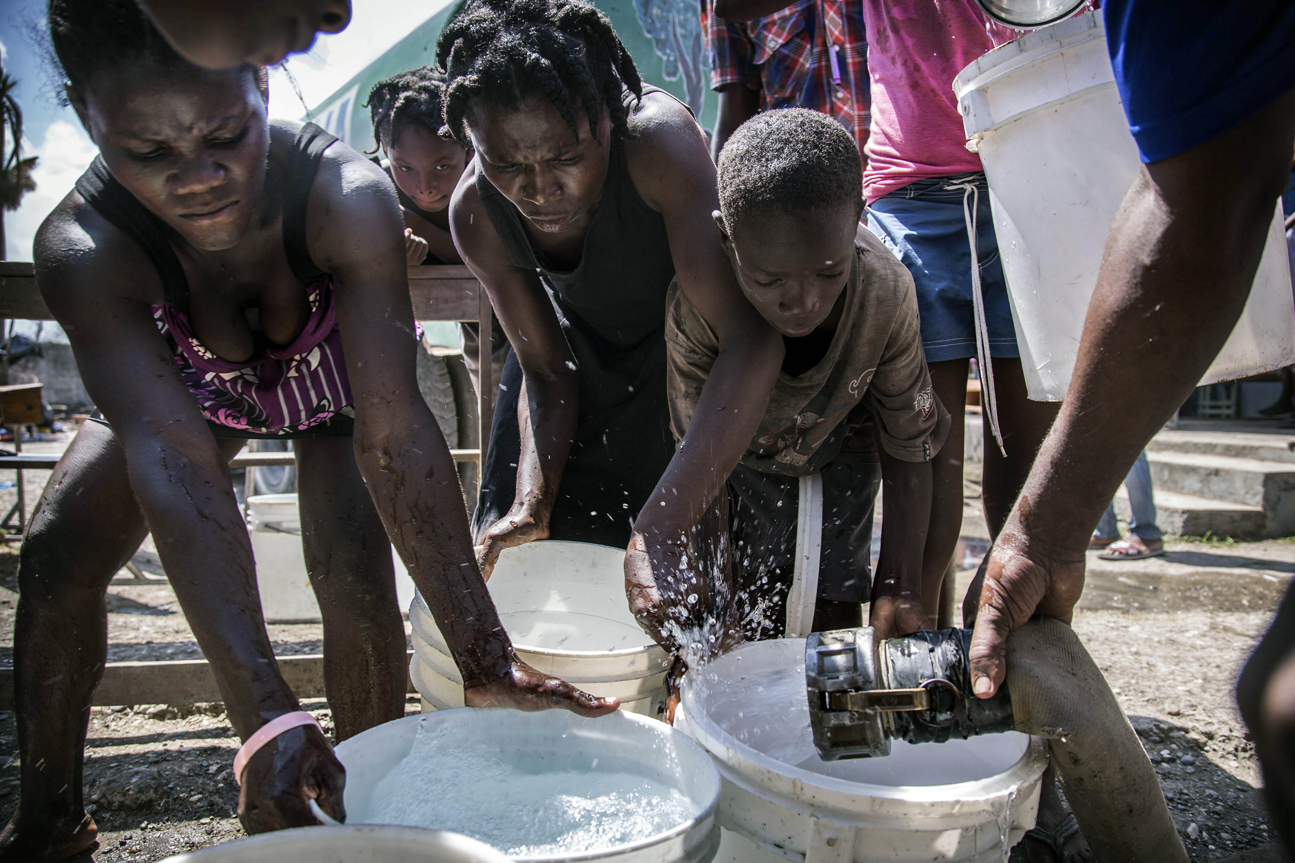
The WASH Project
CKI set a goal of raising $240,000 by 2022
for water, sanitation, and hygiene (wash) initiatives in Haiti!
©UNICEF/DORMINO
Notes:
For example…

Slide 13
Semester Overview

Slide 14
Semester Overview
If you are interested in making a difference, we’d love for you to join!
Our meetings are on [Insert Meeting Date, Time & Location]
Dues are only [$XX]! Pick up a membership application and pay by [date]
[Anything else you want to add!]

Slide 15
Upcoming Events

Slide 16
Upcoming Events
Insert Event #1 (Time, Date, Location)
Insert Event #2 (Time, Date, Location)
Insert Event #3 (Time, Date, Location)
Insert Event #4 (Time, Date, Location)
Insert Event #5 (Time, Date, Location)
Insert Event #6 (Time, Date, Location)
Insert Event #7 (Time, Date, Location)

Slide 17
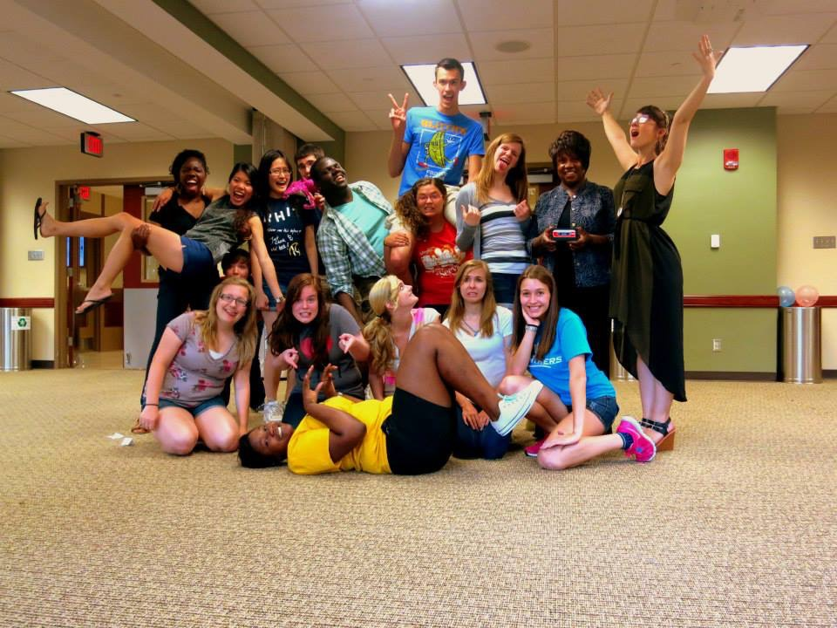
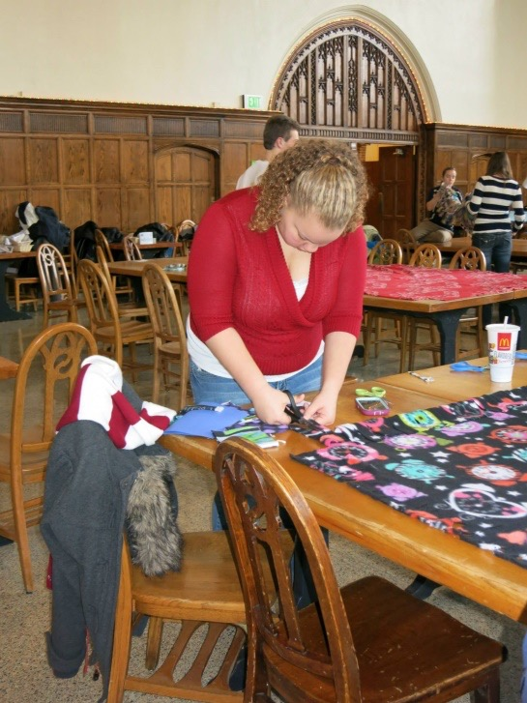
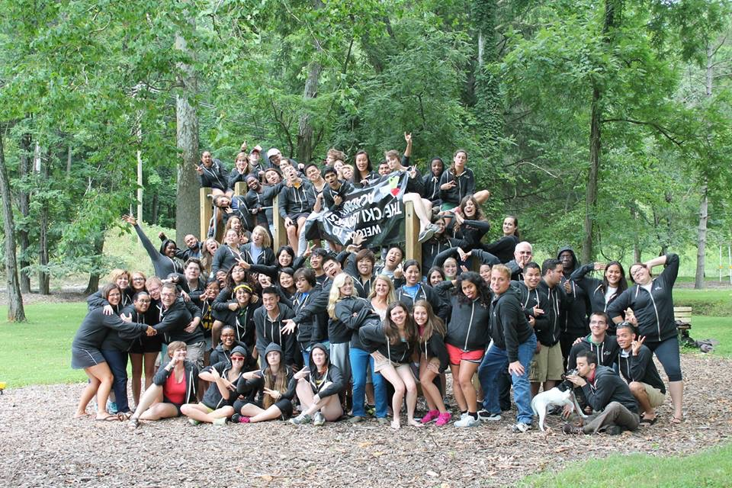
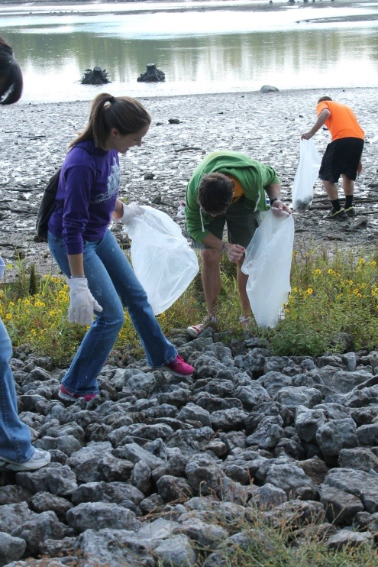
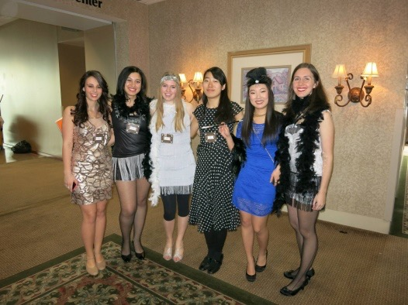
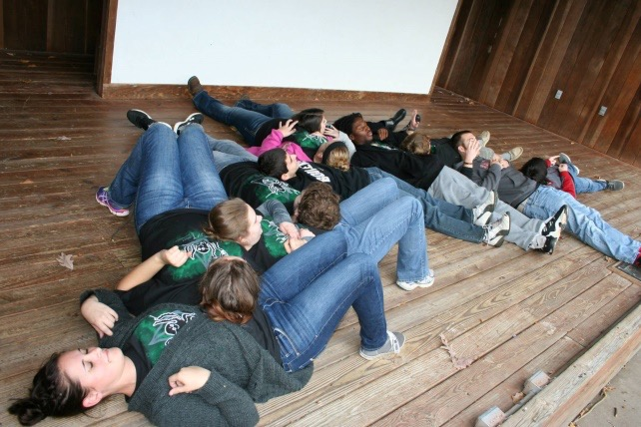
This could be YOU!

Slide 18
[Input pictures of your own club projects if applicable]

Slide 19

Next Meeting Info
[Insert Next Meeting Time and Date Here]
Bring a Friend!

Slide 20
Questions?

Slide 21
Contact Information:
[Your Name]
[Email & or phone number]

