Slide 1
District officer training 2026
P
A
C
K
2026-2027: ENERGIZE
Pennsylvania District
Circle K International

Slide 2
Agenda
Introductions/Ice Breaker
Circle K Overview & Kiwanis Family
Roles and Expectations
District Goals and Information
Club Tools
Membership Retention and Recruitment

Slide 3
Circle K Overview
Circle K was established as a fraternity in 1936 (Kappa Iota Phi) – Washington State College (Pacific Northwest District)
Circle K evolves to service organization in 1947 at Carthage College (Illinois-Eastern Iowa District)
University of Pittsburgh – Johnstown was the first club in Pennsylvania founded in 1957
Pennsylvania District was established in 1962 with 16 clubs
Peter Andrus is the first Pennsylvania Circle K member to be elected as International President in 1968 (University of Pennsylvania)

Slide 4
Circle K Overview
In 1971, Circle K International allows women to become members (the first in the Kiwanis Family)
Pennsylvania elected the first female Governor in the entire Kiwanis Family in 1973 (Dorothy Mihalik – Mansfield State College)
In 1975, the first African American International President is elected (Gregory Faulkner – New York District)
In 1984, the first female International President is elected (Susan McClernon – Minnesota-Dakotas District)

Slide 5
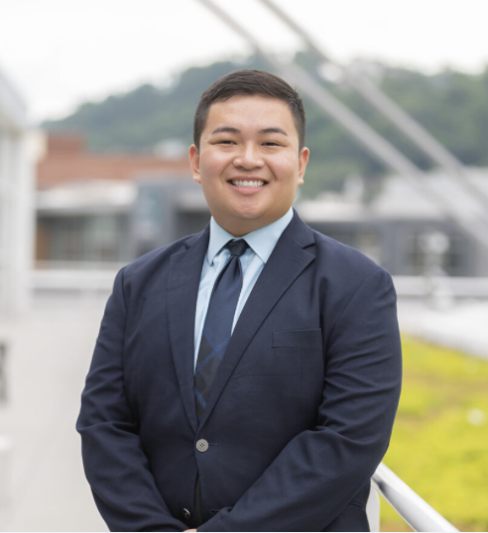
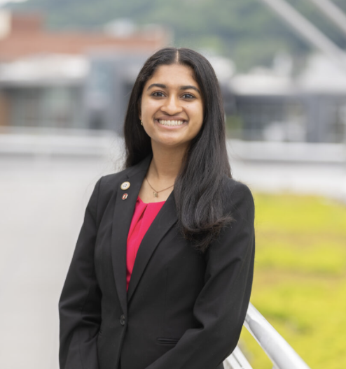
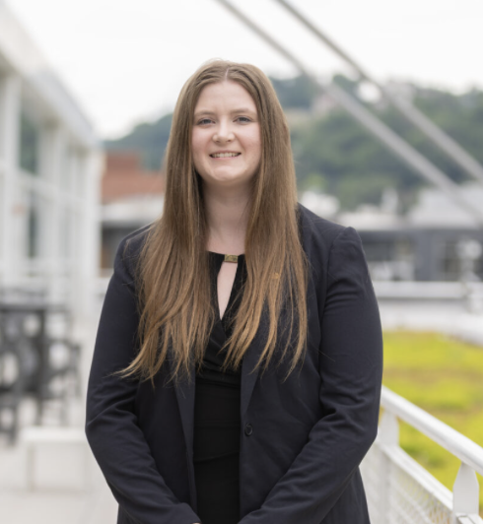
Circle K International Leadership
Sister Districts
Caribbean
Minnesota – Dakotas (MinnDak)
Missouri-Arkansas
(Mo-Ark)
Southwest
International President
Jonathan Huang
New England District
International Vice President
Neha Pasupuleti
Ohio District
International Trustee
Kelly Liland
Western Canada District

Slide 6
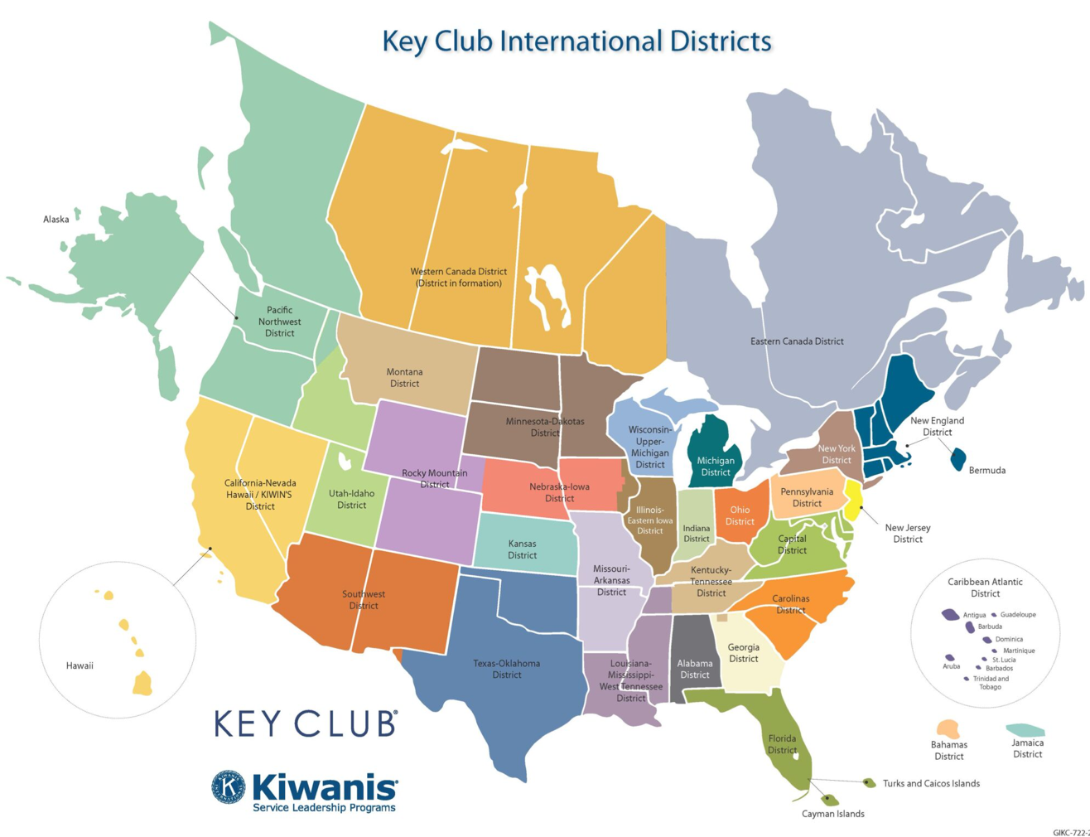

Slide 7
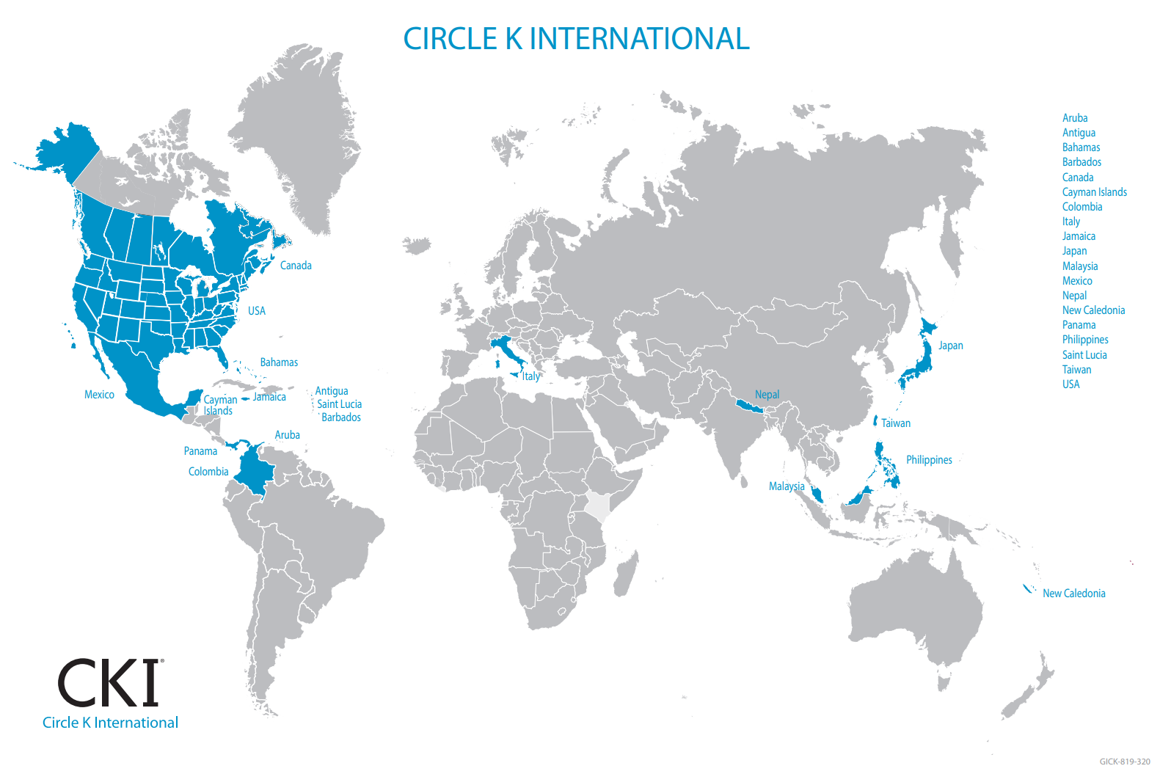

Slide 8


Kiwanis Family
Kiwanis
Aktion Club
Kiwanis is a global organization of volunteers dedicated to changing the world one child and one community at a time.
Provides adults living with disabilities opportunities to give back to their communities, build leadership and decision-making skills, and develop and use their talents
Newest member of the Service Leadership Programs.

Slide 9


Kiwanis Family
Builders Club
K-Kids
Largest service organization for middle school and junior high students
Members learn to work together and develop servant-leaders skills as they serve their school and community
Largest service organization for elementary school students
Can also be chartered at libraries, YMCAs, religious institutions, etc.

Slide 10

Kiwanis Family
Key Club
Oldest and largest service program for high school students
Student-led organization that provides its members with opportunities to provide service, build character and develop leadership
Kiwanis Educates Youth

Slide 11
District Roles and Expectations
Governor
Secretary - Treasurer
Coordinate monthly board meetings with the District Board & Club Officers
Train and support all Club Presidents and Vice Presidents
Ensure District Events are planned
Represent the District at official events
Ensure communication between all levels of Circle K
Keep minutes of all Board Meetings
Train and support all Club Secretaries and club Treasurers
Ensure monthly report forms and dues are submitted
Compile District Directory

Slide 12
District Roles and expectations
Editor
Presidents
Maintain website and social media accounts
Train and support Club Editors
Market District and International events
Educate members of District and International initiatives
Ensure all club officers are trained
Ensure club dues are paid
Ensure monthly report forms are submitted
Attend all board meetings

Slide 13
District Goals
200 members
25 InterPACK
35 DCON
2,700 Service Hours
15 Clubs

Slide 14
Club Roles and expectations
President
Vice President
Run all club and officer meetings
Schedule service projects
Fulfill any requirements required by the school or student government
Stay up to date on all District and International news and share with members
Represent the club at any school, District, or International events
Reserve meeting room (and other tasks delegated by President)
Schedule service projects
Oversee committees and chairs
Attend K-Family meetings
Recognize member strengths and accomplishments
Recruit and retain new and old members

Slide 15
Club Roles and expectations
Secretary
Treasurer
Track service hours for all members
Track K-Family interactions
Submit monthly report form by the 5th of each month through Kiwanis Engage
Send meeting announcements for and minutes from meetings to members
Ensure funding from school/student government
Ensure funding from sponsoring Kiwanis Club
Collect member dues
Focus on membership retention and recruitment
Fundraising

Slide 16
Club Roles and expectations
Editors
Chairs
Publicize club meetings, projects, fundraisers, and other events
Spotlight club and member accomplishments
Share news with local Kiwanis Family clubs and the District Board
Educate members on District and International service initiatives and events
Projects (or a specific project)
Fundraising (philanthropic/administrative)
Socials
Kiwanis Family

Slide 17
Distinguished club Officers Criteria
Trained by Executive Officer
Dues paid member
40 hours of service
Hold office for 6 months
President – attend at least 6 Board/Monthly Meetings
Vice President – attend at least 6 Board/Monthly Meetings
Secretary – Submit at least 9 MRFs on time
Treasurer – Submit dues by 12/1/2026
Editor – Post to social media or publish newsletter once a month (12 times total)

Slide 18
Editor Tasks & Solutions
Publicize club meetings, projects, fundraisers, and other events
Spotlight club and member accomplishments
Share news with local Kiwanis Family clubs and the District Board
Educate members on District and International service initiatives and events
Emails, Social Media, Flyers, Chalking, Table Tents
Birthdays, Honor Roll, Service Hours, Member of the Month
Meetings, Service Projects, District Events (InterPACK, DCON)
District Service Project, Brick x Brick/ UNICEF, International Convention

Slide 19
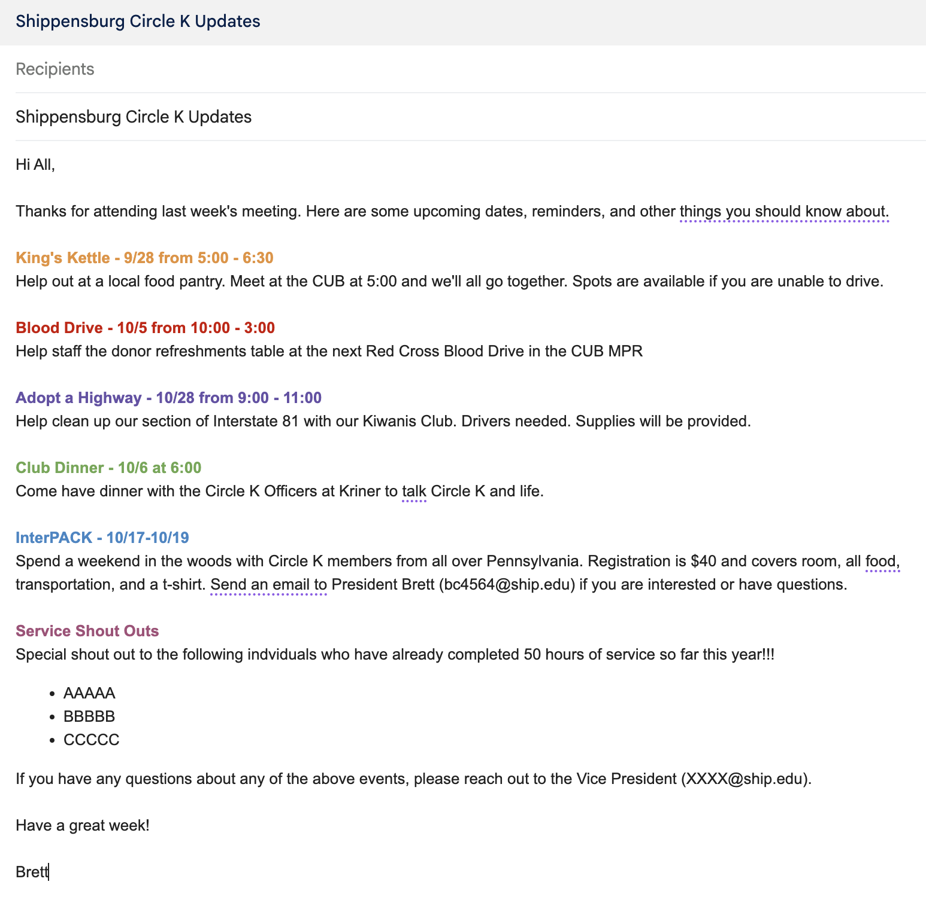
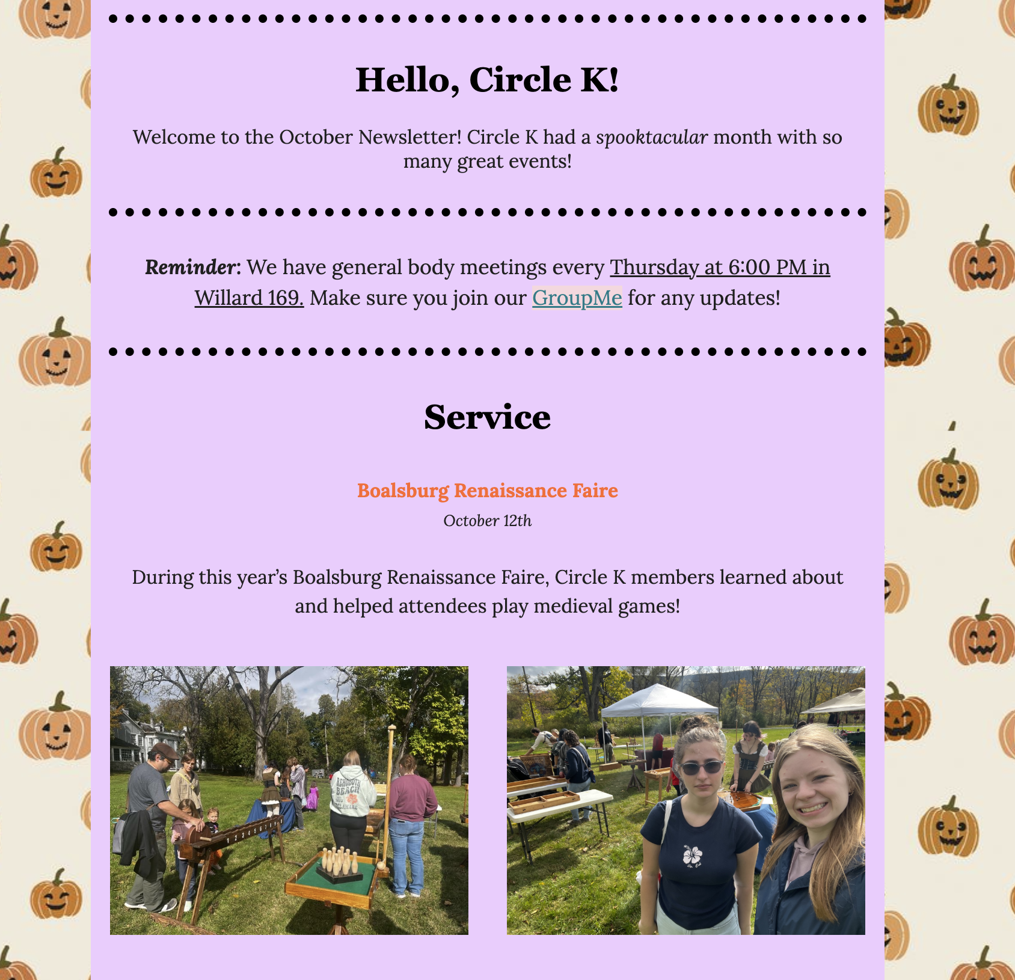
Newsletters
← Email
Mailchimp →

Slide 20
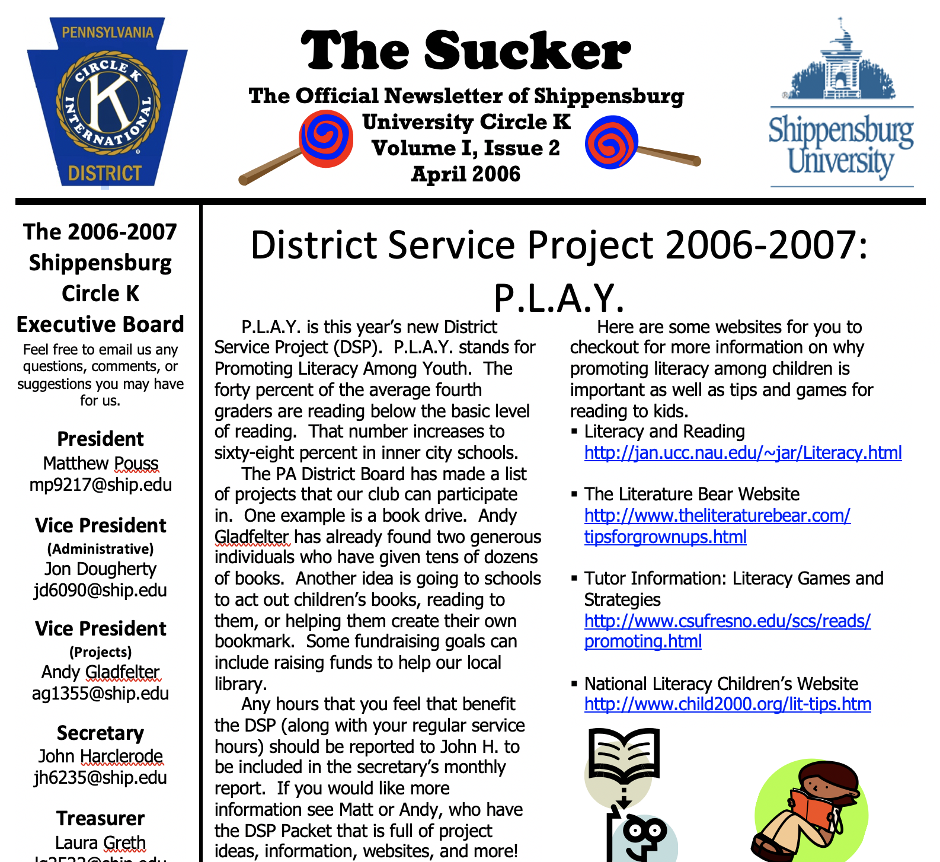
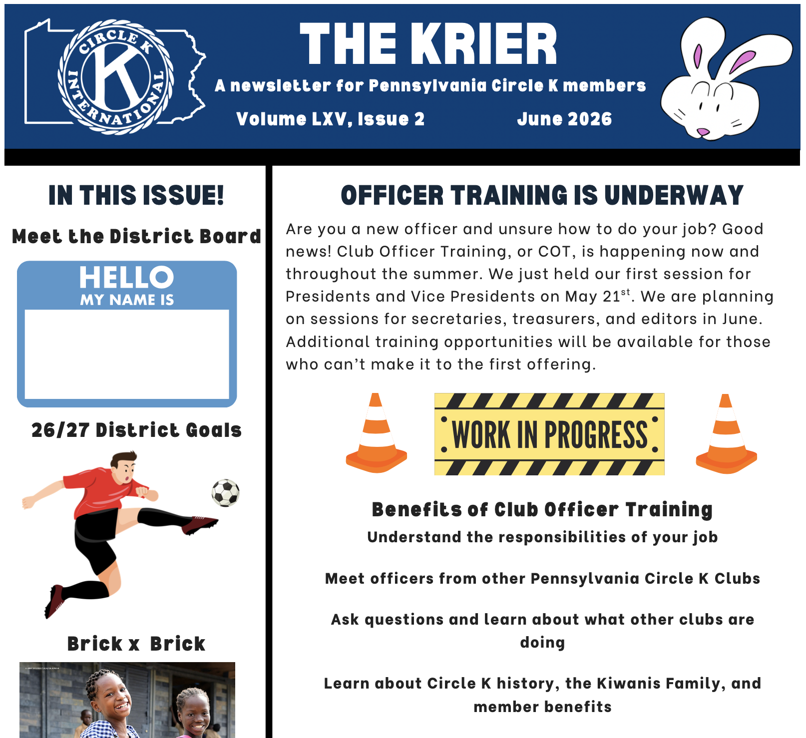
Newsletters
← Microsoft Word
Canva →

Slide 21
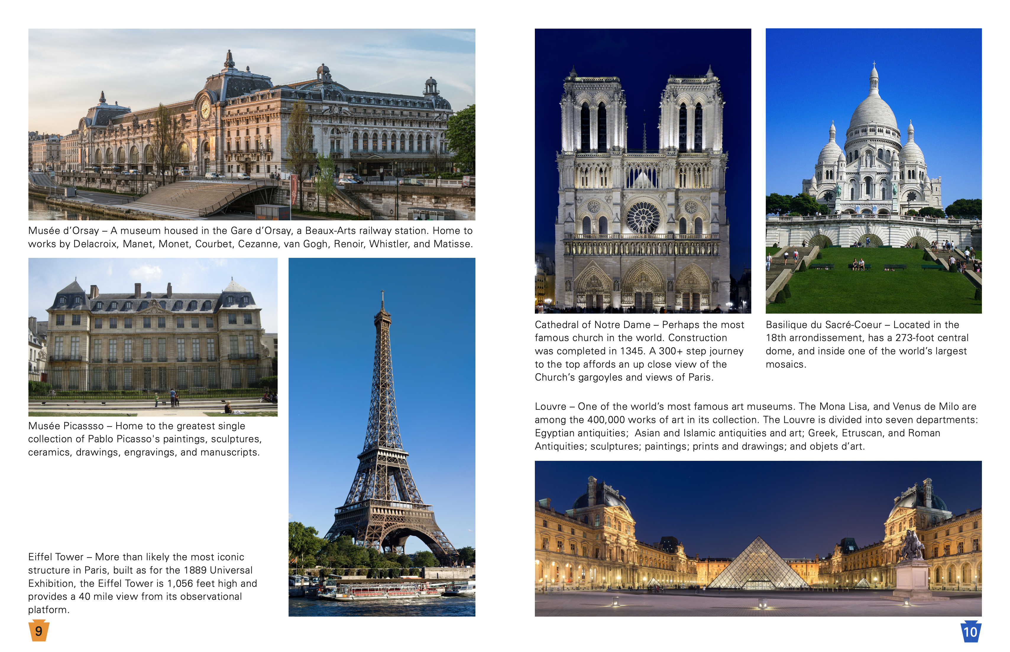
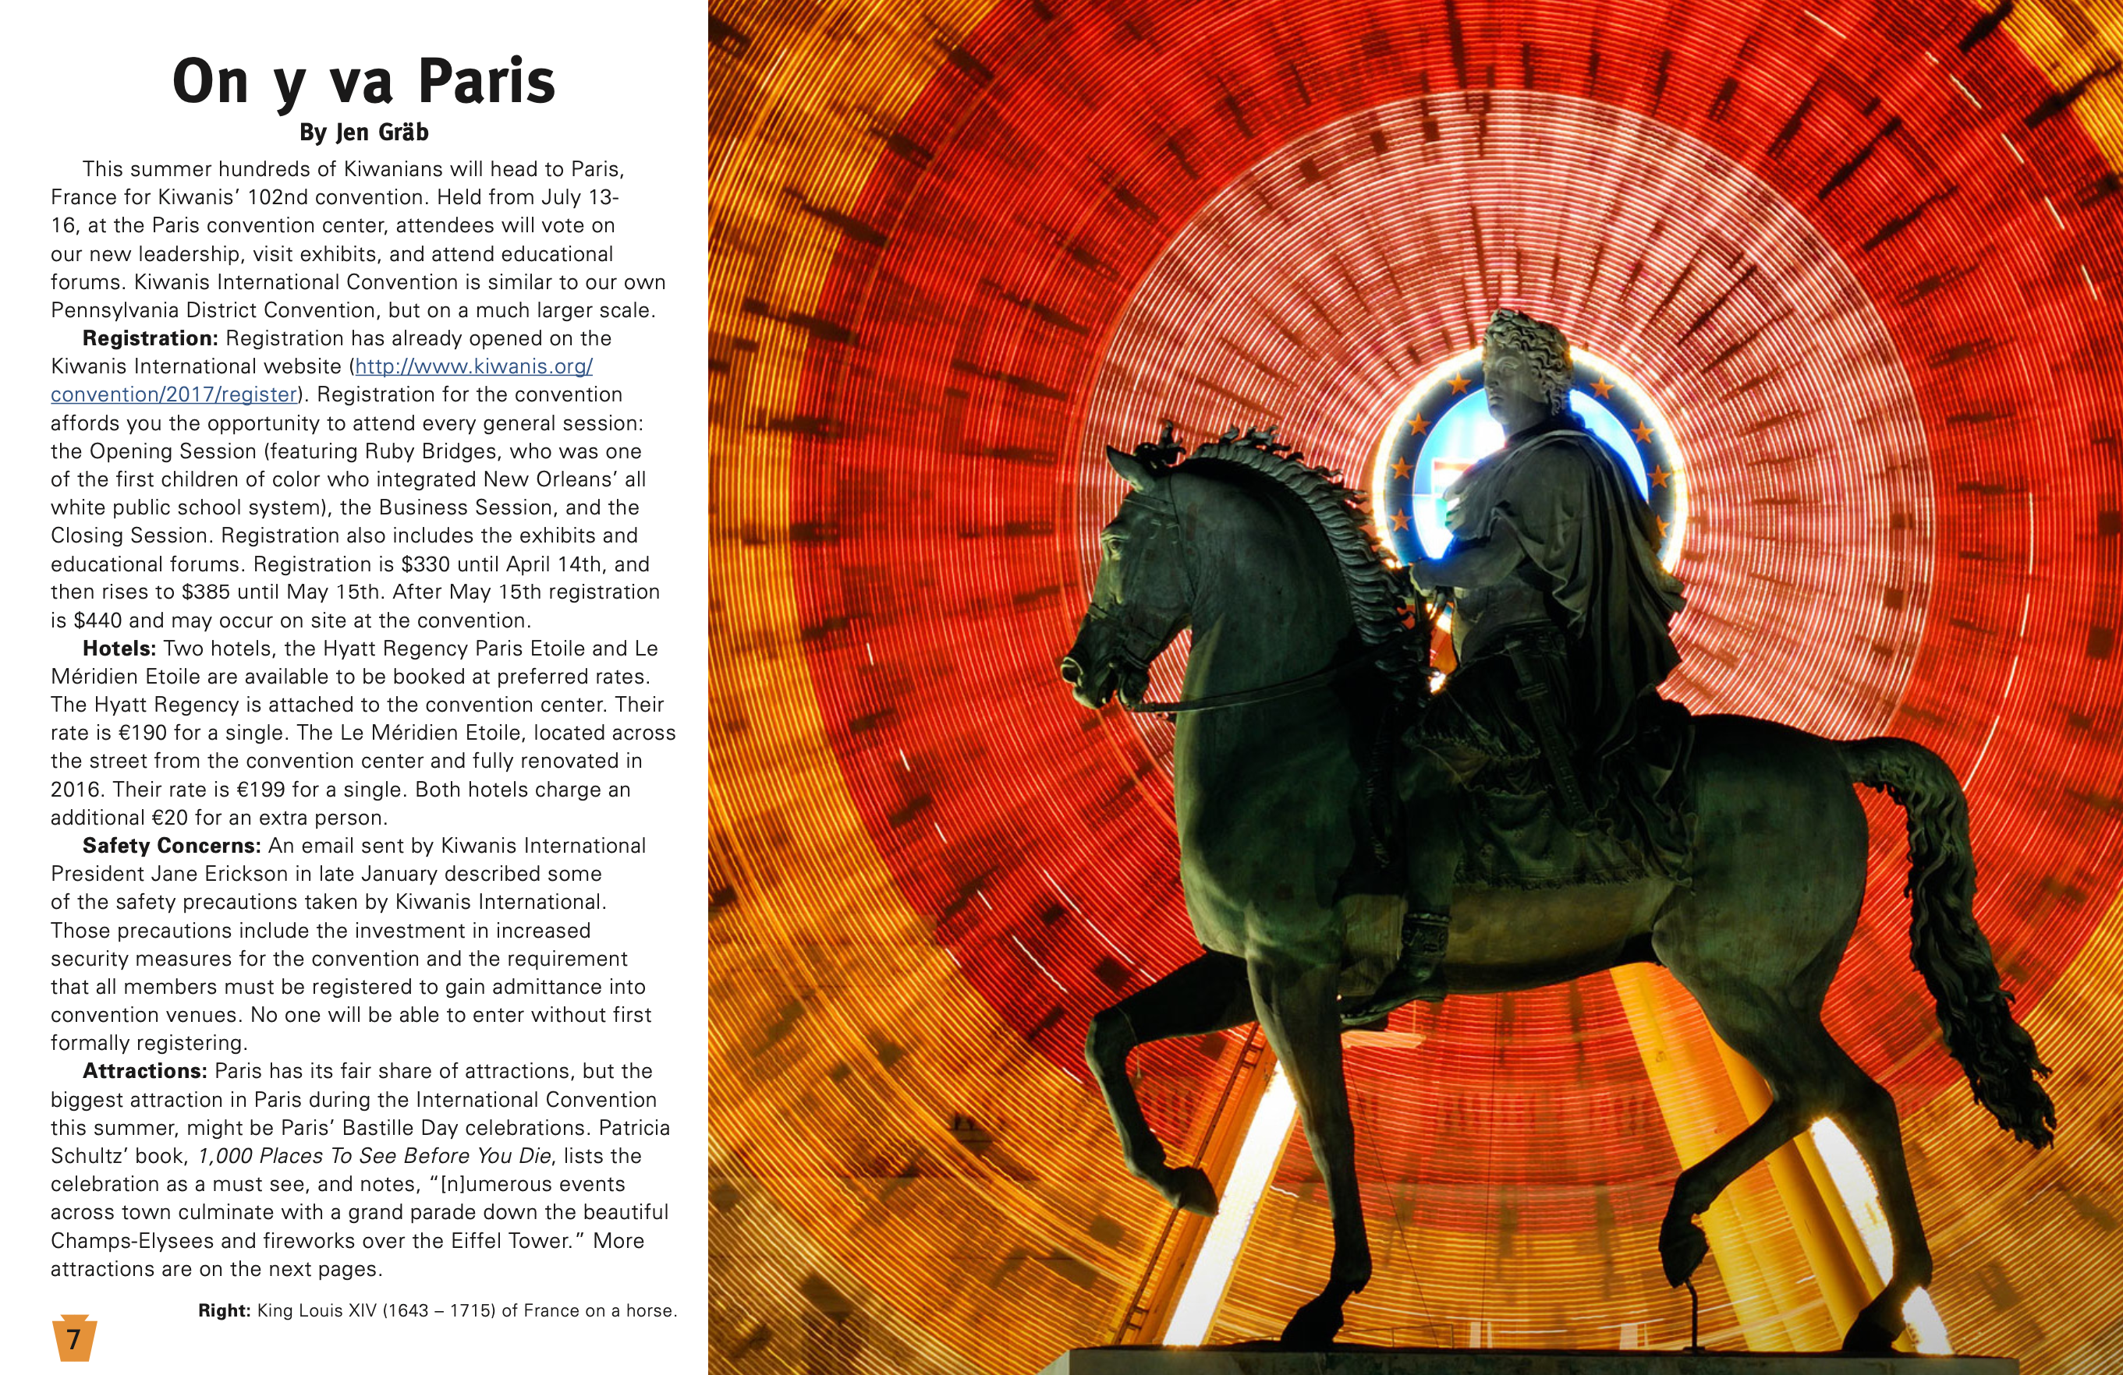
Newsletters
← InDesign

Slide 22
Instagram
Baldwin Wallace University (Ohio): bw_circlekintl
Bowling Green State University (Ohio): bgsu_circlekinternational
Penn State University – University Park (Pennsylvania): weare_circlek
University of California – Irvine (California-Nevada-Hawaii): ckiuci
University of Nevada – Las Vegas (California-Nevada-Hawaii): unlvcki
Florida District: floridacirclek
Michigan District: michigancki
California-Nevada-Hawaii District: cnhcirclek
Paradise Division, Caribbean District: paradisedivision._.cki

Slide 23
Attracting Followers
Consistent/Frequent
On topic/Relatable
Informational – meetings, projects, socials
Promos and/or Recaps
Highlight causes Circle K supports
Target Freshman: #classof2030
Respond to messages timely

Slide 24
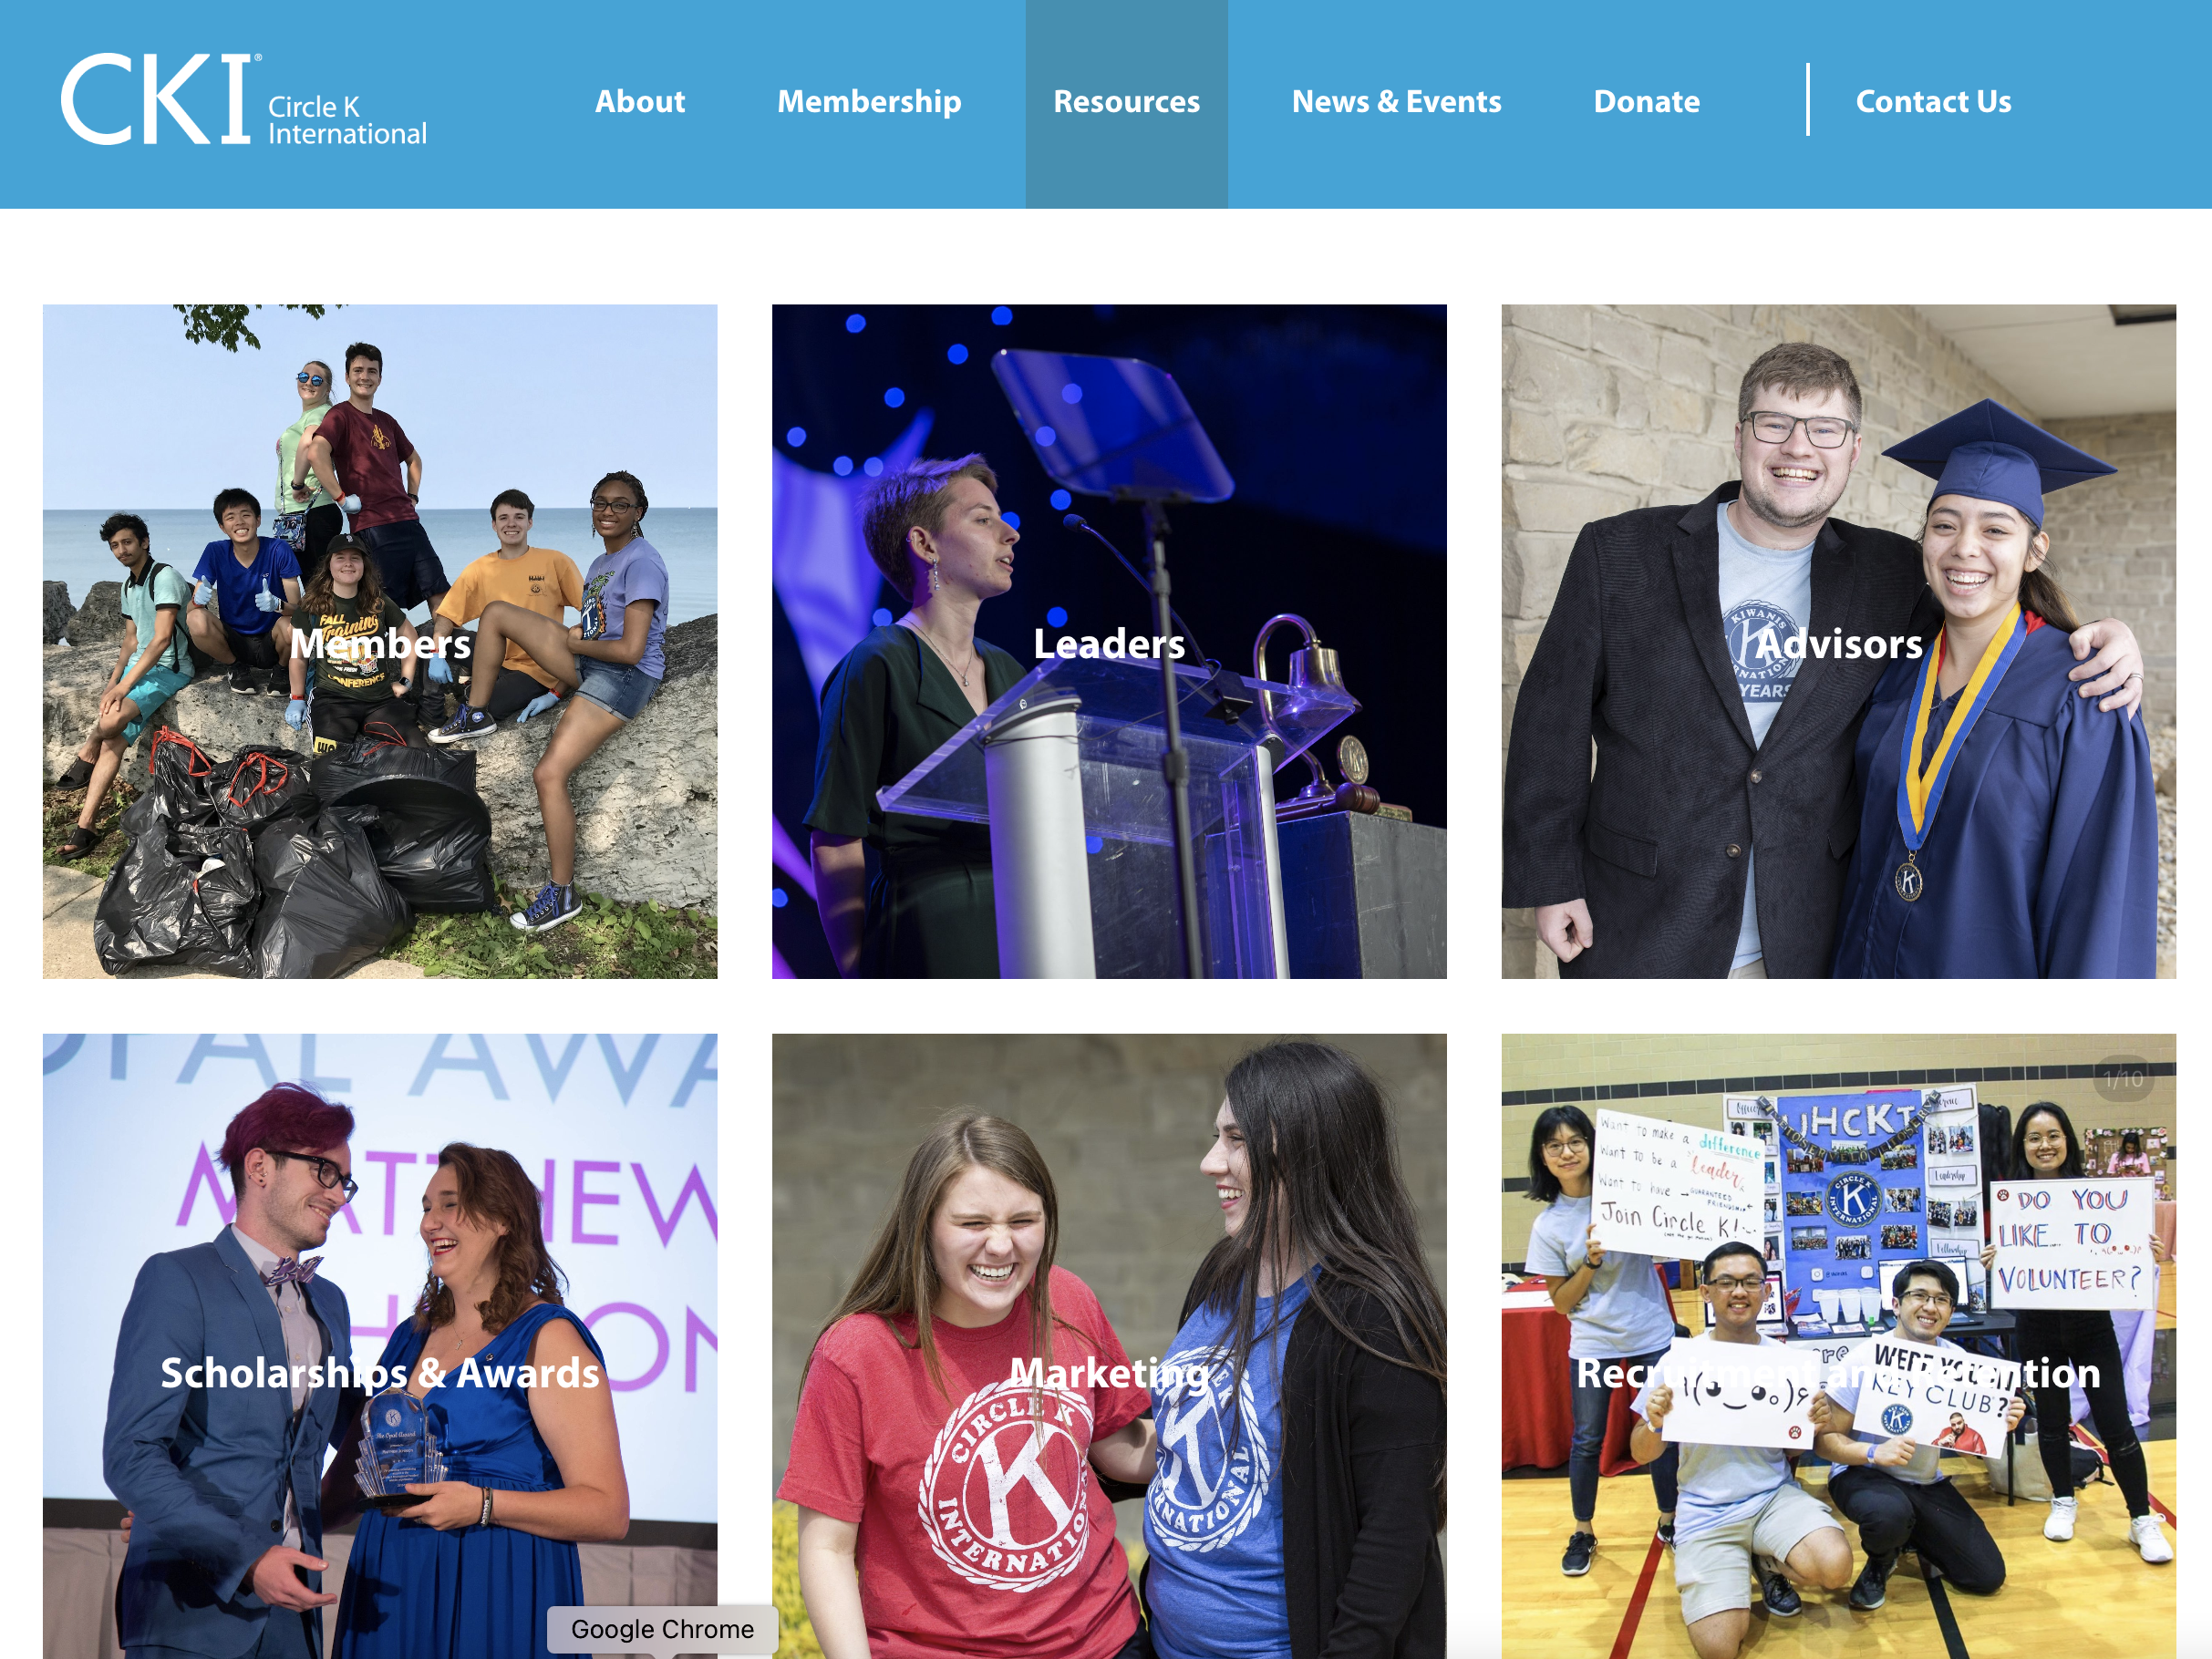
CKI Resources
Flyers
Social Media Templates
Graphics
Brand Guide

Slide 25
What is a service Hour?
Any service completed within or outside Circle K
Travel time to an event
Time fundraising for a charitable cause
Up to 100 administrative hours (planning service events, attending meetings, etc.)

Slide 26
SWOT Analysis
S
W
O
T
Strengths
Weaknesses
Opportunities
Threats

Slide 27
SMART Goals
S
M
A
R
T
Specific
Measurable
Achievable
Relevant
Timely

Slide 28
Delegation
The role is not a one person job
Delegation can
  Lighten you workload
  Help others feel invested in the project or task
  Develop leadership skills in others
  Engage new and motivated members
Before you delegate
  Educate your team on skills or background
  Explain the task demanded of them
  Make sure team is invested
  Define deadlines
  Encourage and support your team

Slide 29
How to run a meeting/Event
MEETING
Prepare yourself, your team, and presenters – what needs to be discussed?
Arrange logistics – time, place, etc.
Send announcements and reminders to members and potential attendees
Be welcoming! Start and end on time.
Summarize important points and announce the next meeting.
EVENT
Decide on the event
Organize the planning and the event
Arrange logistics – time, place, etc.
Set a budget
Publicize
Summarize

Slide 30

Questions
administrator@pacirclek.org

Slide 31
Growing & Retaining Your Club
Brett Cutright
District Administrator
Pennsylvania District
Circle K International

Slide 32
Why CKI?
How do you market Circle K to potential members?
What distinguishes your club from others on campus?
What are you offering members?
“Create an experience and community united in service”
  Common interest is community service
  Experience is service projects, socials, and meetings
  Community are the members you engage with activities and interactions despite location and campus size.

Slide 33

How to attract New Members
Advertising
Tabling
Key Club

Slide 34


Advertising
Flyers, posters, etc.
  Free templates on circlek.org
  Sidewalk chalking
Table tents
  Display at dining hall tables
Social media
  Post regularly, frequently
  Engage with audience
  Informative but brief
  Eye-catching

Slide 35
Tabling
BIGGEST recruitment opportunity of the year! Use our Tabling Guide.
Sign up sheet/Interest form/QR Code
Brochures/literature/candy
  Free templates at circlek.org
  Everyone likes candy!
Displays
  Create a trifold with pictures and descriptions of activities and socials
Circle K shirt
  Wear a Circle K shirt
Bring your banner
  The logo may be recognizable to Key Club alumni
MEMBERS
  Make sure you have people stationed at the table to talk to potential members and increase foot traffic

Slide 36

Mates Racing

Slide 37

Key Club
Use the Circle K Logo in your posters and advertisements
Display your banner (it will look similar to the Key Club banner)
  Activities fair
  Campus wide events (Relay for Life, Homecoming, etc.)
  Projects open to the campus (blood drives, fundraisers, etc.)

Slide 38
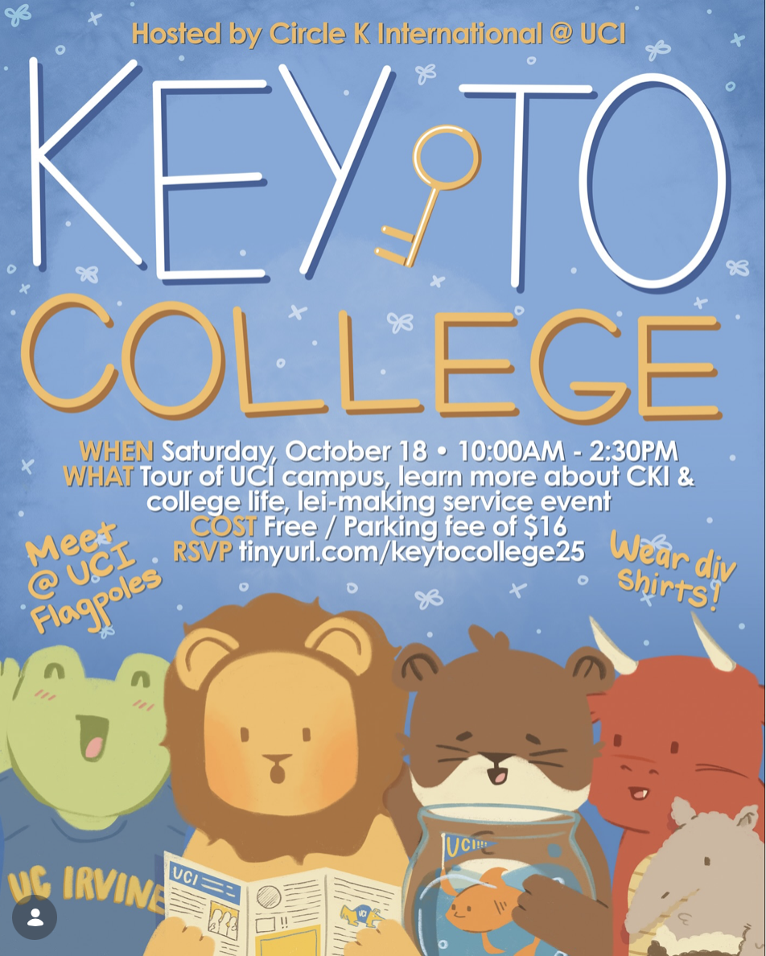
Key Club
Key to College
  Talk to your local Key Club seniors about college
  Contact administrator@pacirclek.org to find a Key Club if you are not near one

Slide 39

How to retain current Members
SERVICE
Self evaluate
Your first meeting
Develop membership
Recognize membership

Slide 40
Service
Evaluate your community and campus for potential projects
Reach out to Kiwanis to offer support or project ideas
Research your interests
Plan 3 significant projects for members before you mention dues

Slide 41
Self evaluate
What worked and didn’t work over the past year?
  Meeting times, socials, service projects, etc.
Did you meet your goals? What are your goals for the upcoming year?
Plan over the spring and summer
What is something new you want to do this year?
Diversity
  Majors
  On campus vs. off campus vs. commuters

Slide 42
Your First meeting
Divide the old to conquer the new
  Have officers and seasoned members around the room to welcome and talk to new members
Mentor new members
  Pair old and new members/bigs and littles
Do you have food?
  Lure potential members to your first meeting with pizza, ice cream, soft pretzels, cookies, etc.
What fun events or socials do you have planned?
  Club outings (movies, mini-golf, snow tubing, bowling, dinners out, etc.)
  Club dinners on campus or pot luck
  “Unofficial meetings”

Slide 43

Develop membership
Remain in contact with existing members
  Catch up on campus
  Contact over breaks
Promote new opportunities
  Leadership positions, projects, InterPACK, DCON, ICON
Identify future leaders
  Ask them if they want to help plan a project/event (chair)
  Ask them to be an officer

Slide 44
Recognize membership
Regular membership recognition
  Member of the month
  Academic achievement
  Service hours
  Birthdays
  General appreciation
  Happy Thoughts/You Rock Rock
  Social media
Inclusion
  Ensure everyone feels included
  If members can’t make a meeting or event, provide an alternate activity that fits in their schedule
  Try to have a diverse line up of projects/events to appeal to different members

Slide 45
Legacy
Club view
  What does Circle K look like after you graduate?
  Does the club know how to function without you?
  What is your legacy?
  Is the club set up to succeed next year and in the future?
Membership view
  Did you recruit underclassman?
  Did you develop leadership for the future?
  Do you have a successor for your position? Did you identify a successor?
  Did your predecessor train you? Did you train your successor?

Slide 46
Finally and most importantly

Slide 47
Be active
Plan over the summer for the upcoming year (especially fall)
  Meeting dates, time, location planned (if possible)
  What recurring projects do you have planned?
  Are you planning any big projects?
What District events are you going to?
  InterPACK – October/November
  District Convention – March
  International Convention – Summer
  Funding
What fun events or socials do you have planned?
  Club outings (movies, mini-golf, snow tubing, bowling, dinners out, etc.)
  Club dinners on campus or pot luck
  “Unofficial meetings”
Celebrate your accomplishments, DON’T REST ON THEM

Slide 48
Questions
administrator@pacirclek.org

