Slide 1


Officers Council Meeting
AGENDA
Role Call
Welcome, Icebreaker, and Introductions
Board Updates
Announcements and Goals Updates
Club Updates
Official Business
Guest Commentary/Open Forum
Trivia
Adjournment
Pennsylvania District
Circle K International
18 August 2026

Slide 2
Role Call
Bucknell University
Carnegie Mellon University
Drexel University
Duquesne University
East Stroudsburg University
Elizabethtown College
Lycoming College
Penn State University – University Park
PennWest University – Edinboro
Susquehanna University
University of Pittsburgh – Greensburg
University of Pittsburgh – Oakland
University of Scranton
District Secretary-Treasurer
District Administrator

Slide 3
Welcome, Introductions, Ice Breaker
🎉
🤬
Name, School
What is your most and/or last used emoji?
💯
🌮
👍
😭
🗿
🐉
🥐
🍩
🍕
❤️
😮
🏏
💸

Slide 4
Board Updates
International Trustee
District Secretary-Treasurer
District Administrator
Outline
Work and Accomplishments
Successes
Concerns and Club Support
Goals Update
Questions, Comments, Announcements

Slide 5
Announcements
Club Officer Training
  Presidents and Vice Presidents – 5/27, 7/16, 8/18
  Secretaries and Treasurers – 7/7
  Editors and Chairs – 7/9, 8/16
  Fall?
InterPACK 2026
  October 16-18, 2026 – Duncansville, PA
  Registration not final, but around $15
  (includes housing and food)
  Volunteering at St. Vincent de Paul Community Gardens in Hollidaysburg
  Theme?

Slide 6
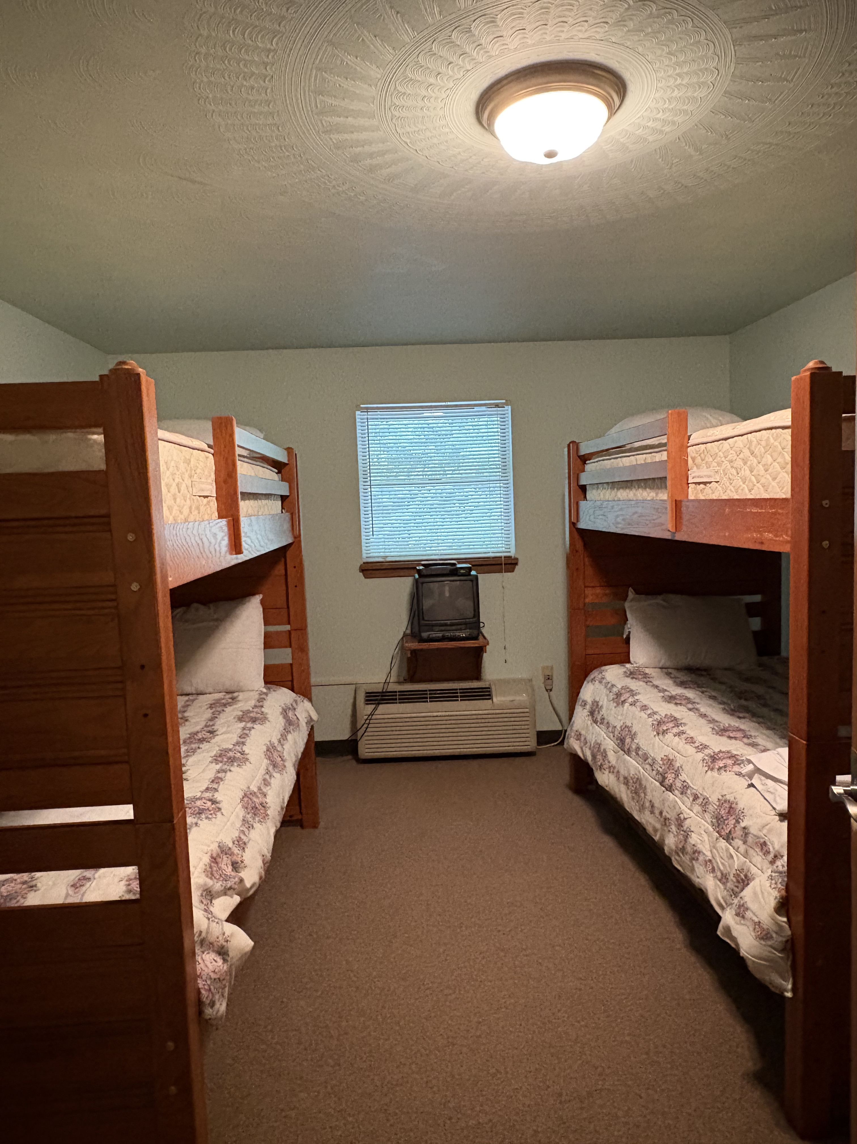
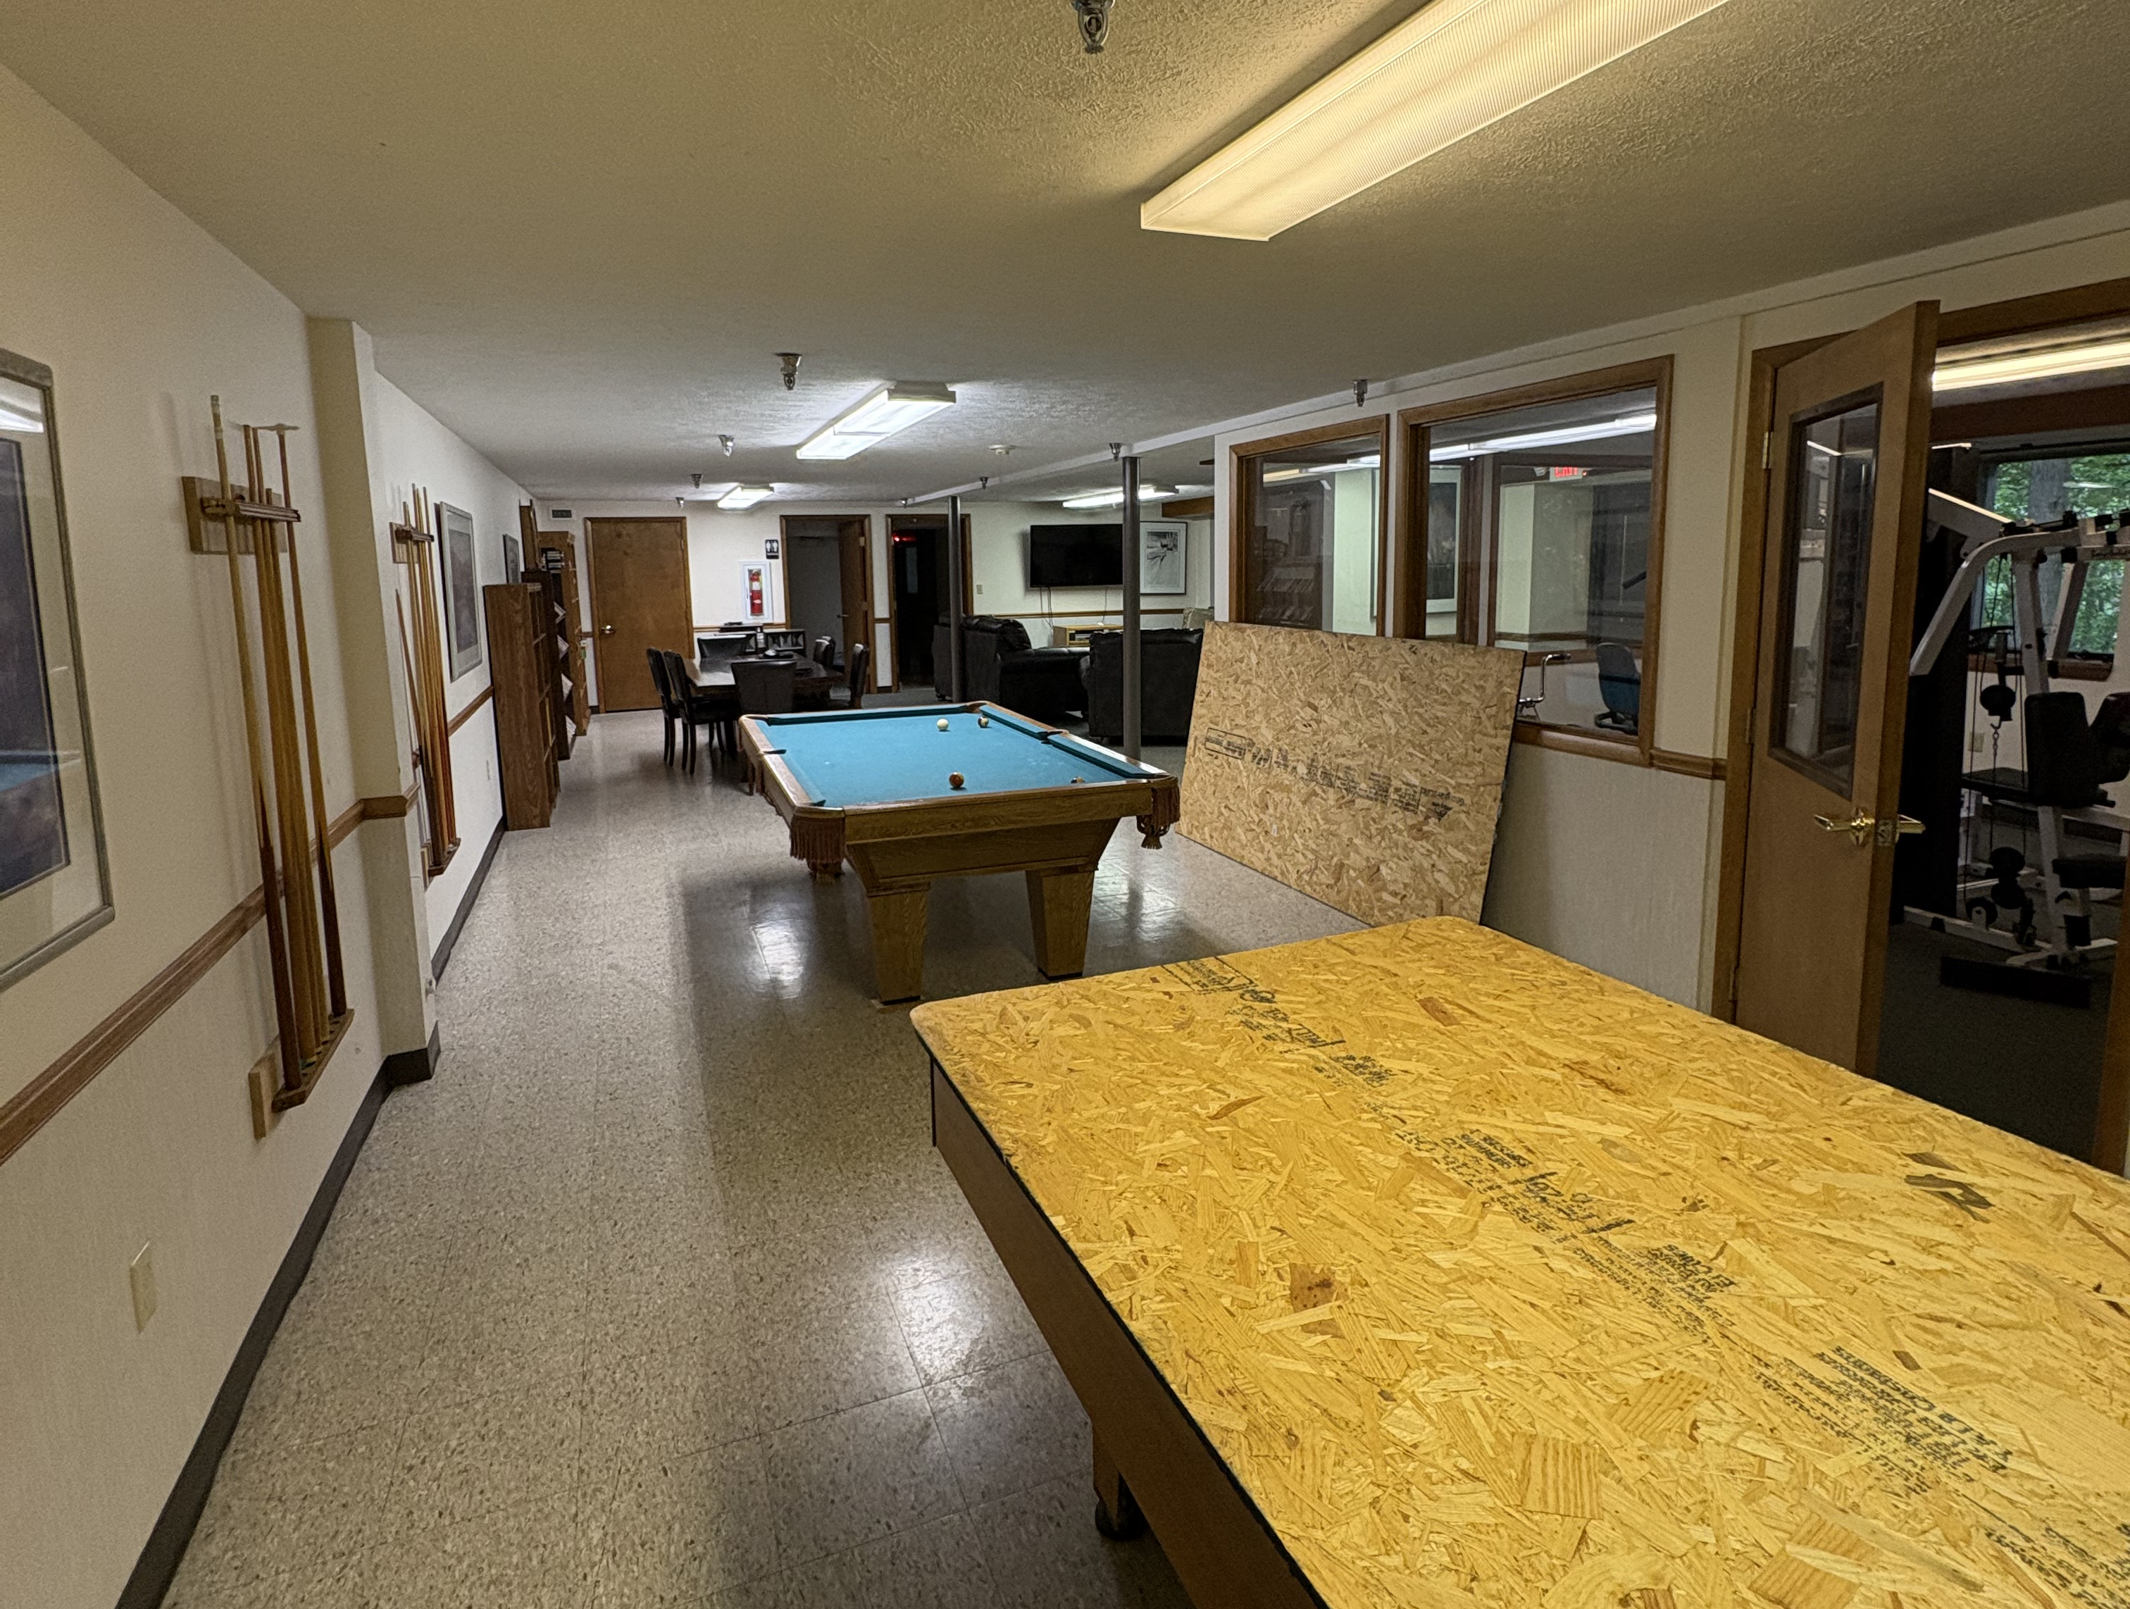
Announcements
InterPACK 2026 Notes
  Bedding and Towels provided
  Recommend shower shoes
  Dorm and hotel

Slide 7
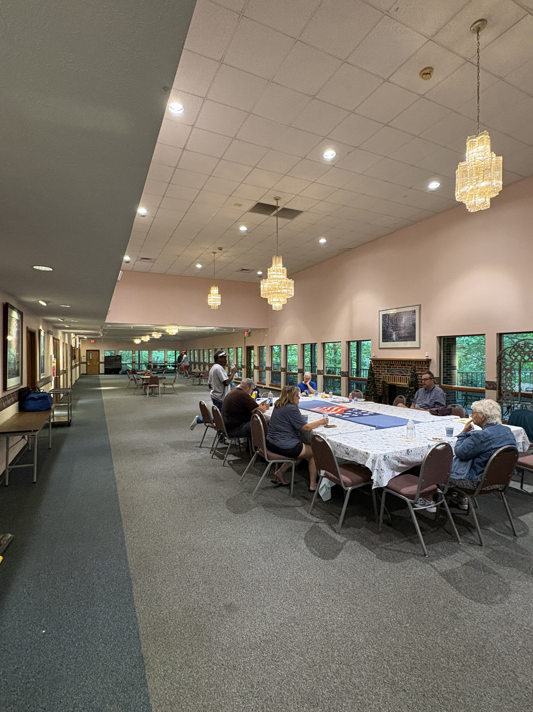
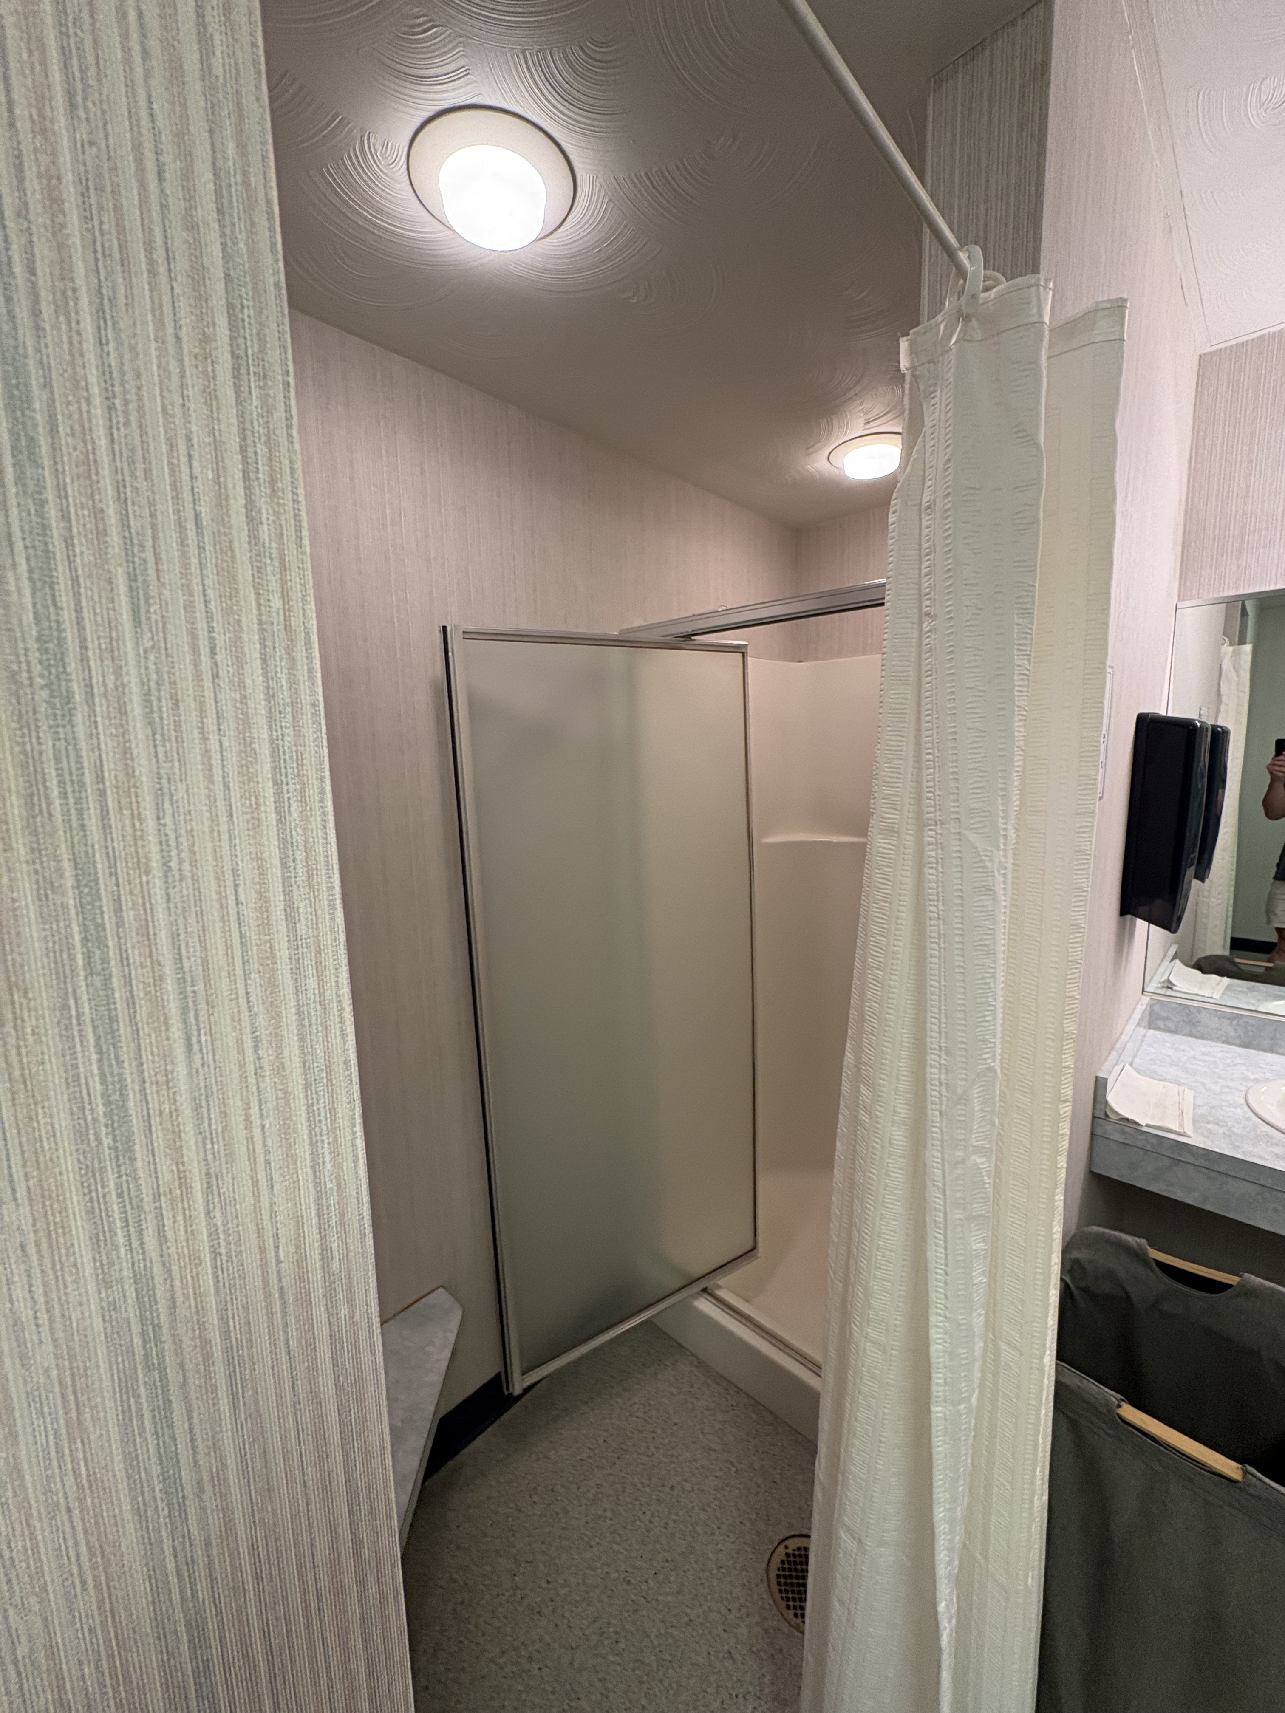
Announcements

Slide 8

Announcements
Monthly Report Forms
T-shirt or Pin for members? Ideas?

Slide 9
Announcements
International Dues increase
  $36 → $44
  District Dues remain at $10
Dollars for Dues
  Suspending this initiative, but if there is financial hardship for dues with your members, please let the District Board know

Slide 10
Goals Updates
The Pennsylvania District will have 200 members by March 31, 2027.
This goal will start being tracked on 10/01/2026.
The Pennsylvania District will complete 2,700 service hours by March 31, 2027.
As of 08/06/2026 we have reported 253 hours. That is 9.37% of our goal.
The Pennsylvania District will have 15 active clubs by March 31, 2027.
This goal will start being tracked on 10/01/2026.
The Pennsylvania District will have 30 Kiwanis Family Events by March 31, 2027.
As of 08/06/2026, we have reported 6 events. That is 20.00% of our goal.
The Pennsylvania District will train 75% of all club officers.
As of 08/06/2026, there are 51 officers with contact information and 22 have been trained. That is 43.14% of our goal

Slide 11
Goals Updates
The Pennsylvania District will have 4 members at International Convention in Dallas, Texas.
The Pennsylvania District sent 5 members to ICON. That is 125% of our goal.
The Pennsylvania District will have 25 members at our fall conference, InterPACK.
This goal will be measured after InterPACK has concluded.
The Pennsylvania District will have 35 members at District Convention.
This goal will be measured after District Convention has concluded.

Slide 12
Club Updates
Question of the month
  What are your plans for membership recruitment and retention this fall? Are you trying anything new?
Accomplishments, challenges, etc.

Slide 13
Official Business
Appointment of Marisa Gray, PennWest University – Edinboro, as District Editor
Appointment of Paul Horne, Duquesne University, as District Governor
Budget Approval
DCON 2027 Location Approval
  Greensburg – Hampton Inn – $116/night + taxes and fees
  State College – Ramada – $149/night + taxes and fees
Fall Meeting Schedule
  Availability survey or fixed day
  Other input
The Jared Box Project

Slide 14
Official Business
Infant (0 to 12 months)
Softcover books, cardboard books, rattles, bibs, stacking blocks, farm animal sets, small toys that clip on strollers or cribs, crib mirrors, bath toys, stuffed animals, balls, busy boxes, light-up toys, musical toys, Oball toys. Lamaze©, Bright Starts©, and Sassy© brand toys are great. Other toys that are labeled as suggested for infants. Be aware of choking hazards.
Toddler (1 to 3)
Softcover books, cardboard books, stacking blocks, farm animal sets, small toys that clip on strollers or cribs, bath toys, stuffed animals, balls, busy boxes, musical toys, colorful pillowcases, fun socks, chunky crayons, coloring books, picture flashcards, plastic cars and trucks, puppets, soft dolls. Other toys that are labeled as suggested for children under 3. Be aware of choking hazards.
Preschool (3 to 5)
Crayons, coloring books, grab-n-go activity kits, reading books, stickers, sticker workbooks, activity books, matchbox cars, NERF or rubber balls, stuffed animals, flashcards, fun socks, small action figures, small dolls, travel size games, Silly Putty, simple puzzles, card games (Go Fish, Old Maid, Memory), colorful pillowcases, princess crowns, dress up items, farm animal sets, dinosaurs. Other toys that are labeled as suggested for Preschoolers.
Elementary (5 to 8)
Crayons, markers, colored pencils, pens, coloring books, word searches, activity books, reading books, joke books, matchbox cars, NERF balls, stuffed animals, stickers, Silly Putty, LEGO kits, craft kits, Slinky, travel games (Sorry, Connect 4), hand lotion, colorful pillowcases, reusable water bottle, fun socks, action figures, puzzles, deck of cards, UNO card game. Other toys that are labeled as suggested for school-aged children.
Tweens & Teens (8 and up)
Crayons, markers, colored pencils, pens, coloring books, word searches, doodle pads, writing journals, Silly Putty, stuffed animals, card games, LEGO kits, puzzles, brain games, books, magazines, Chapstick©, hand lotion, fun socks, colorful pillowcases, jewelry making kits, craft kits, paint sets, reusable water bottle. Other items that are labeled as suggested for teens.

Slide 15
Trivia
What is the CKI motto?

Slide 16
Trivia
Live to Serve, Love to Serve

Slide 17
Open Forum
Questions, concerns, or comments?

